Slide 1
Pathogen Genome Data My life in sequences
Leighton Pritchard

Slide 2
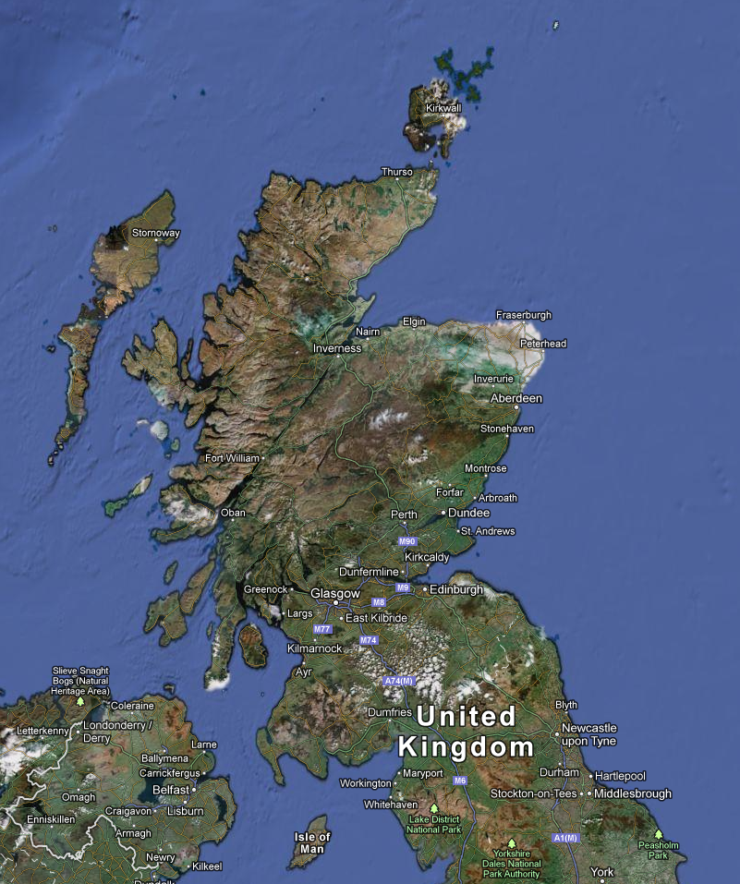
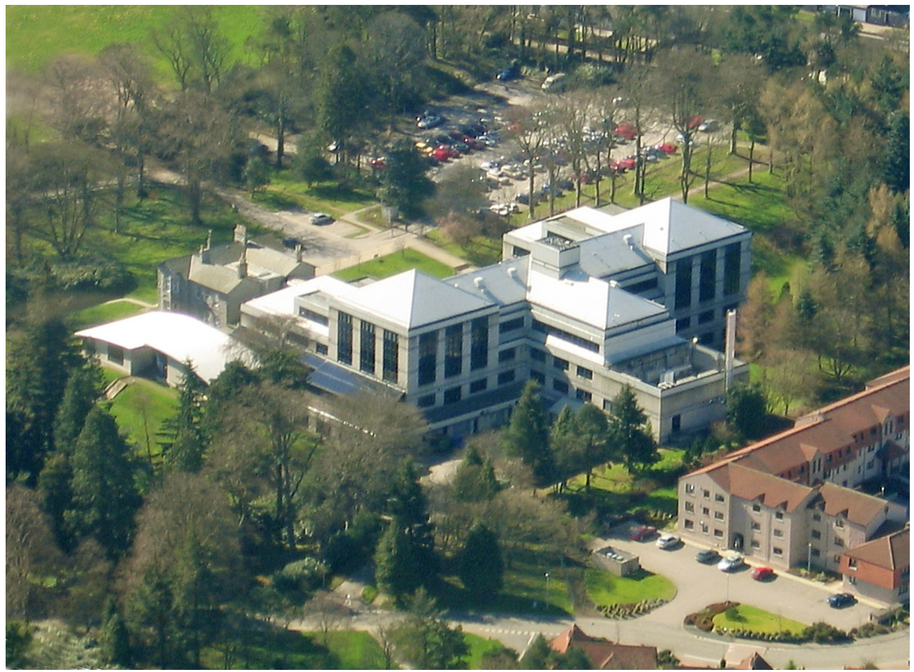


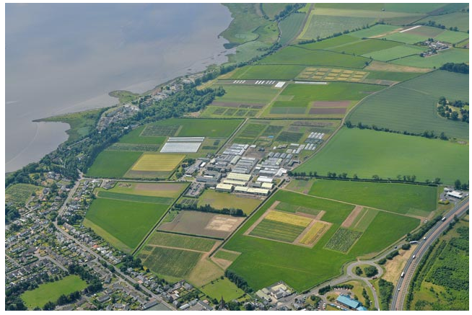
The James Hutton Institute
Land use
Crop research

Slide 3


The James Hutton Institute
Formed from the Scottish Crop Research Institute (SCRI, Dundee) and Macaulay Land Use Research Institute (MLURI, Aberdeen) in 2011
Oversees Biomathematics and Statistics Scotland (BioSS)
University of Dundee Division of Plant Sciences based at Dundee site
http://www.hutton.ac.uk

Slide 4
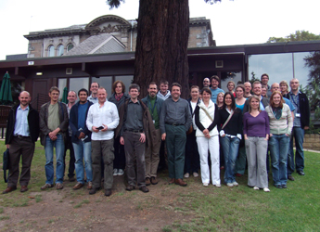
Centres of Expertise
Centre for Research on Potato and Other Solanaceous Plants: http://www.hutton.ac.uk/research/groups/cell-and-molecular-sciences/crps
The Dundee Effector Consortium (DEC; with University of Dundee): http://www.hutton.ac.uk/research/groups/cell-and-molecular-sciences/dundee-effector-consortium
Centre for Human and Animal Pathogens in the Environment (HAP-E): http://www.hutton.ac.uk/research/themes/controlling-weeds-pests-and-diseases/hape

Slide 5
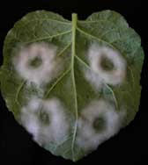
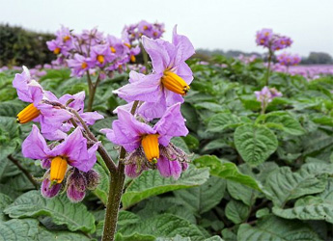
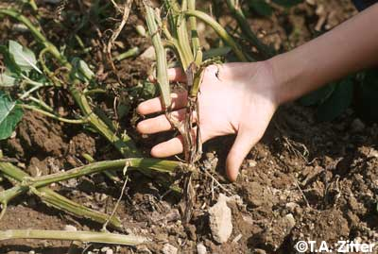
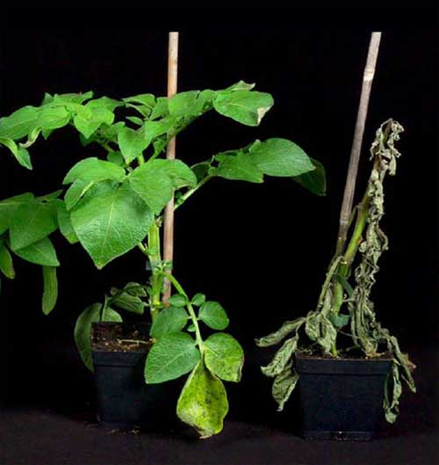
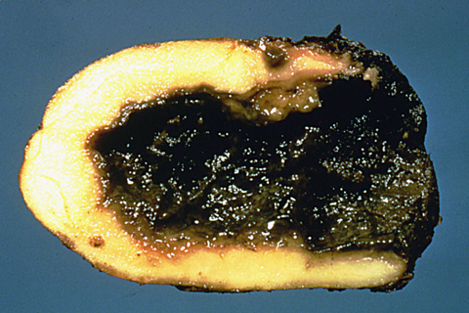
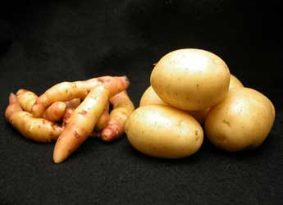
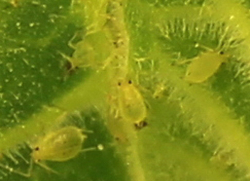
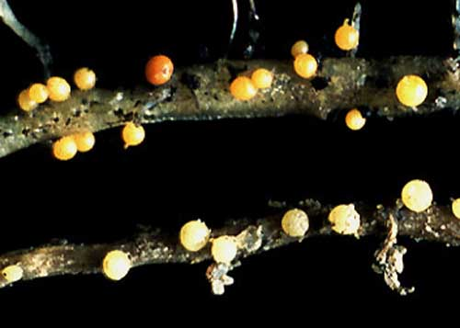
Plant-pathogen interactions
Pectobacterium, Erwinia and Dickeya spp.
Phytophthora infestans
Myzus persicae
Potato Cyst Nematode

Slide 6
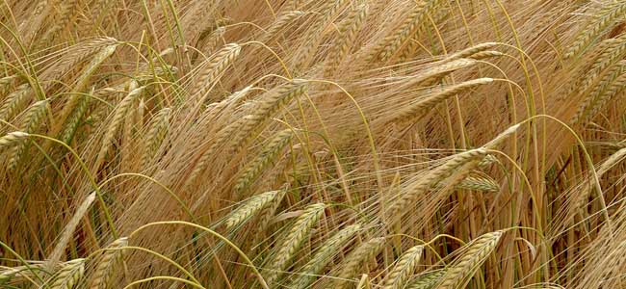
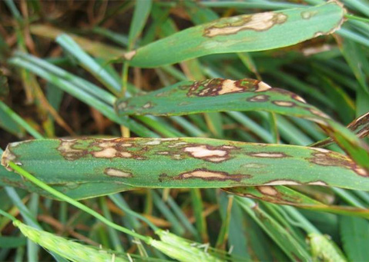
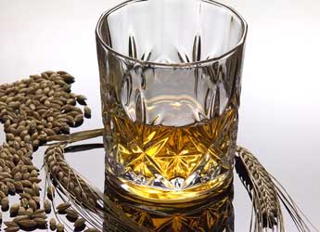
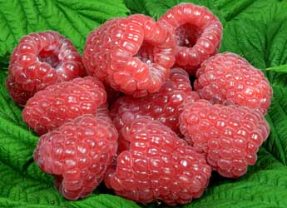
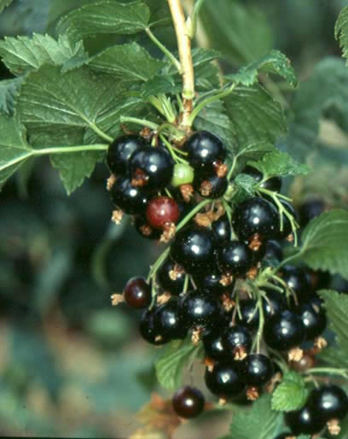
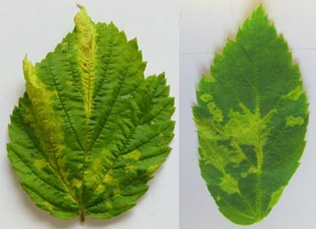
Plant-pathogen interactions
Rhynchosporium commune
Raspberry Leaf Blotch Virus

Slide 7
Plant-pathogen interactions: policy
Food security
Societal impact
Extensive burden and cost of crop disease
P. infestans €1bn in Europe; ≈$4bn global
Emerging pathogens (imports and climate change)
Environmental sustainability
Pesticide minimisation and withdrawal
Durable resistance via breeding (and/or GM)
Based on existing resistances

Slide 8
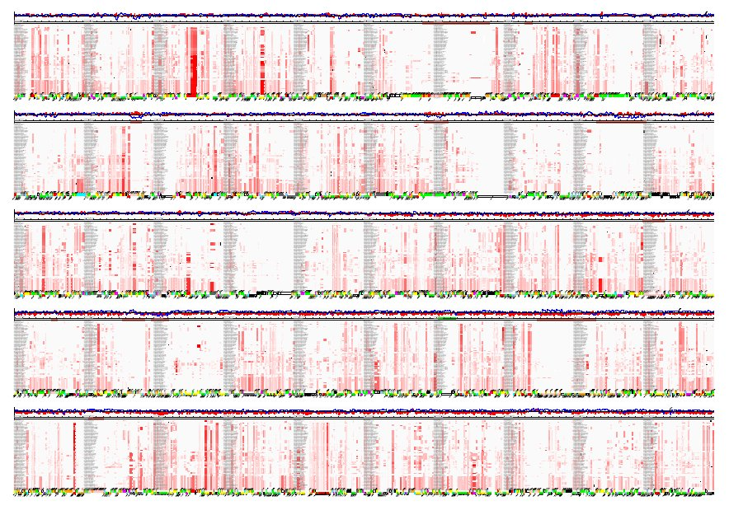
Introduction
2003: Erwinia carotovora subsp. atroseptica
2009: Phytophthora infestans
2013: Dickeya spp.
Conclusion

Slide 9
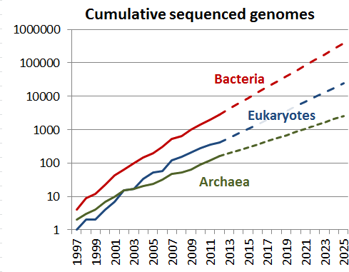
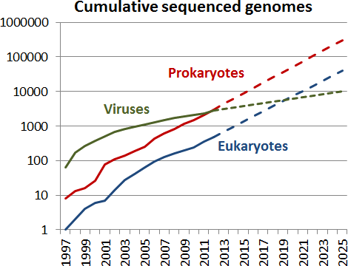
Introduction
Figures and code from: http://sulab.org/2013/06/sequenced-genomes-per-year/

Slide 10
Introduction
As the number of sequenced genomes rises…
The collective power of genomics to explain biology increases…
The impact of a single genome falls…
The impact of a single genome paper falls faster…
The time available for any scientist to annotate and examine an individual genome in detail falls even faster than that!
I discovered this the hard way… here are some of the other lessons I learned

Slide 11
Introduction
What can pathogen genome data do for you?
Catalogue of genome components
Differences in genomic complement: hypotheses for function
Characteristic signals for diagnosis and epidemiology
Parts lists and wiring diagrams for systems and synthetic biology
How do we get to biology from genome data?

Slide 12
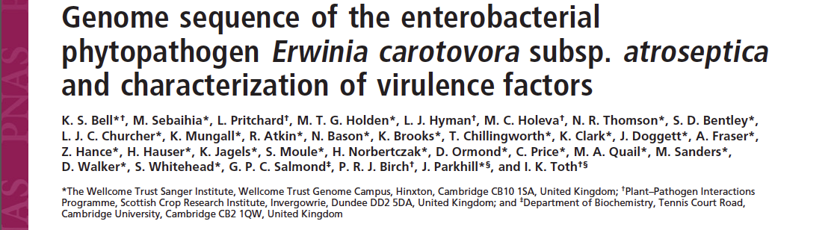
2003: Erwinia carotovora subsp. atroseptica
Bell et al. (2004) Proc Natl Acad Sci USA doi:10.1073/pnas.0402424101.

Slide 13
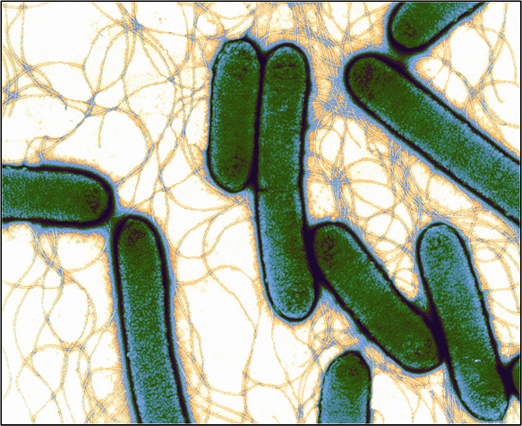
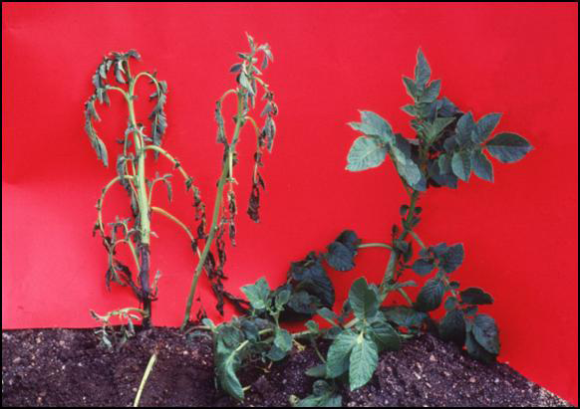
Pectobacterium atrosepticum
Plant pathogenic enterobacterium
E. carotovora subsp. atroseptica reclassified as Pectobacterium atrosepticum
Causes blackleg (stem rot), rotting of stored tubers
Major rot symptoms due to PCWDEs

Slide 14
Pectobacterium atrosepticum
First plant pathogenic enterobacterium to be sequenced
£250,000 collaboration between SCRI, University of Cambridge, and WT Sanger Institute
WGS to 10.2X coverage, 106,500 reads
Repeats and gaps bridged and sequenced directly
A single complete high quality 5Mbp circular chromosome
Published 2004, PNAS (32 authors) Bell et al. (2004) Proc Natl Acad Sci USA doi:10.1073/pnas.0402424101.

Slide 15
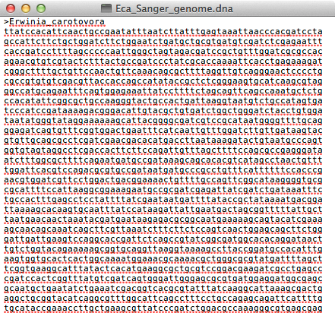
Pectobacterium atrosepticum
Having a genome sequence is useful, but…
Relive the annotation with Artemis!
Eca_Sanger_genome.dna
Eca_Sanger_annotation.gbk
Manual annotation by Sanger Pathogen Sequencing Unit:
gene ID: FASTA, BLASTN, BLASTX
genecalls: ORPHEUS, GLIMMER
domain ID: PFAM, SIGNALP, TMHMM
metabolism: KEGG
ncRNA: RFAM
Literature search and comparison
≈6 people, ≈6 months

Slide 16
A Word About Annotation
Almost all use of genomics depends on annotation: annotation quality is critical to downstream biology!
Annotation is curation, not cataloguing!
Annotation/curation of new genomes often has no budget (not a new situation: Enzyme Nomenclature Committee never funded…)
Automation from curated data is the ONLY game in town, but you can’t propagate something that does not exist! (≈30% of metabolic activity has no known gene associated with it)
Core, well-curated resources are essential (and costly) (420 gene entries curated per year per FTE is considered reasonable)
(Dirty little fact: biocurators can spend as much time “de-annotating” literature-based annotations as entering new data)
Chen and Vitkup (2007) Trends Biotech. doi:10.1016/j.tibtech.2007.06.001 Bairoch (2009) Nature Precedings. doi:10.1038/npre.2009.3092.1

Slide 17
Another Word About Annotation
Biocuration (i.e. maintenance of reliable annotation corpus) also requires:
software platforms and interfaces (web-based is good…)
controlled vocabularies and ontologies (GO, PAMGO, SO, …)
computing and network infrastructure, IT and sysadmin support
Community annotation: “Many potential parents, but no-one wants to look after the children”
Key problem: lack of direct incentives to curate (one’s own) data.
Solution: ELIXIR and centralised resources, e.g. EBI (Ensembl etc.)
Bairoch (2009) Nature Precedings. doi:10.1038/npre.2009.3092.1

Slide 18
Comparative Genomics
Having a single genome is useful, but…
…the real power of genomics is comparative genomics
The combination of genomic data and comparative and evolutionary biology to address questions of genome structure, evolution and function.

Slide 19
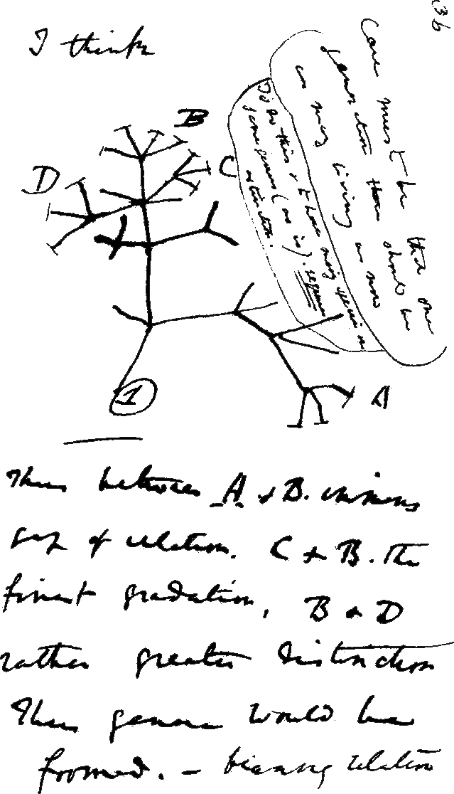
Why Comparative Genomics?
Genomes describe heritable characteristics
Related organisms share ancestral genomes
Functional elements encoded in genomes are common to related organisms
Functional understanding of model systems (E. coli, A. thaliana, D. melanogaster) can be transferred to non-model systems on the basis of genome comparisons
Genome comparisons can be informative, even for distantly-related organisms

Slide 20
Why Comparative Genomics?
Genomic differences can underpin phenotypic (morphological, physiological, host range, virulence) differences
If phenotypes or other organism-level properties are known, comparison of genomes may give mechanistic or functional insight into differences (e.g. environmental persistence).
Genome comparisons aid identification of functional elements on the genome.
Studying genomic changes reveals evolutionary processes and constraints.

Slide 21
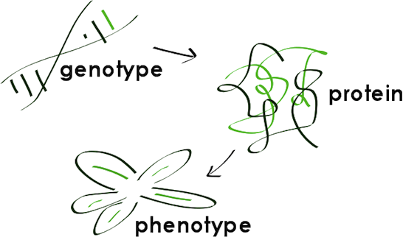
Caveats of Comparative Genomics
BUT: the genome isn’t everything
Context: epigenetics, tissue differentiation, mesoscale systems, etc.
Phenotypic plasticity: responses to temperature, stress, environment, etc.
(therefore Systems Biology, of which more later…)

Slide 22
Levels of Genome Comparison
Bulk Properties
chromosome/plasmid counts and sizes,
nucleotide content, k-mers, etc.
Whole Genome Sequence
sequence similarity
genomic structure and organisation (rearrangements), etc.
Genome Features/Functional Components
numbers and types of features (genes, ncRNA, regulatory elements, etc.)
organisation of features (synteny, operons, regulons, etc.)
complements of features
selection pressure, etc.

Slide 23
Pba Comparative Genomics Questions
Just about enough sequenced genomes in 2002/3 to ask:
What are the gene complement similarities and differences between Pba and:
other enterobacteria?
other plant pathogens?
animal pathogens?
other environmental bacteria?
What is genomic evidence for pathogenicity determinants?
Do pathogenicity determinants show evidence of LGT?
Are there characteristic features of the Pba genome?

Slide 24

Who let the –logues out?
Evolutionary relationships of genome features can be complex.
We use precise terms to describe relationships between genome features.

Slide 25
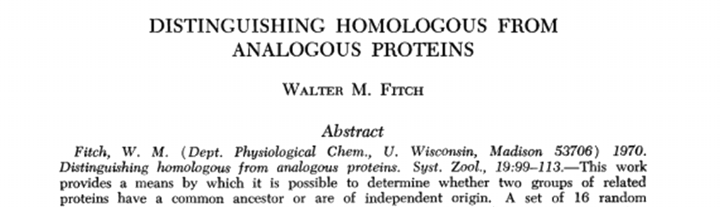
Comparing Gene Features
Given gene annotations for more than one genome, one can organise and understand relationships in multiple ways
Functional similarity (analogy)
Evolutionary common origin (homology, orthology, etc.)
Evolutionary/functional/family relationships (paralogy)
Terms first suggested by Fitch (1970) Syst. Zool. doi:10.2307/2412448
Fitch (2000) Trends Genet. doi:10.1016/S0168-9525(00)02005-9

Slide 26
Attack of the –logues
Important technical terms describing feature relationships
Homologues: elements that are similar because they share a common ancestor (NOTE: There are NOT degrees of homology!)
Analogues: elements that are (functionally?) similar, maybe through convergent evolution rather than common ancestry
Orthologues: homologues that diverged through speciation
Paralogues: homologues that diverged through duplication within the same genome
(also co-orthologues, xenologues, etc.)
Fitch (1970) Syst. Zool. doi:10.2307/2412448
Fitch (2000) Trends Genet. doi:10.1016/S0168-9525(00)02005-9

Slide 27
Attack of the –logues
genome
ancestral genome feature
time

Slide 28
Attack of the –logues
genome
ancestor: ftA
speciation
time
species1:ftA
species2:ftA
orthologues
Orthologues: homologues that diverged through speciation

Slide 29
Attack of the –logues
genome
ancestral copy:ftA
duplication
time
copy 1:ftA
copy 2:ftA’
paralogues
Paralogues: homologues that diverged through duplication within the same genome

Slide 30
Attack of the –logues
genome
ancestor:ftA
speciation
time
species1:ftA
species2:ftA
duplication
species1:ftA’
species1:ftA
species2:ftA
in-paralogues
(co-)orthologues
(co-)orthologues/out-paralogues

Slide 31
Attack of the –logues
genome
ancestor:ftA
speciation
time
species1:ftA
Species2:ftA
duplication
species1:ftA’
species1:ftA
species2:ftA
species2:ftA’
in-paralogues
orthologues
in-paralogues
out-paralogues/(co-)orthologues

Slide 32
Attack of the –logues
BUT: biology is not well-behaved: relationships can be difficult to infer
Gene loss occurs
Homologues can diverge – sometimes very widely: hard to recognise
Reconstructed evolutionary trees for speciation events may not be robust
We don’t have a record of history, we can only infer it!
Kristensen et al. (2011) Brief. Bioinf. doi:10.1093/bib/bbr030

Slide 33
Attack of the –logues
historical events
genome
ancestor:ftA
speciation
Species2:ftA
time
species1:ftA
duplication
species1:ftA’
species1:ftA
species2:ftA
species2:ftA’
extensive divergence
species1:ftA?
species1:ftA
species2:ftA?
in-paralogues
out-paralogues/(co-)orthologues?
contemporary
sequence
out-paralogues/(co-)orthologues?
Classifications of orthology/paralogy are inferences

Slide 34
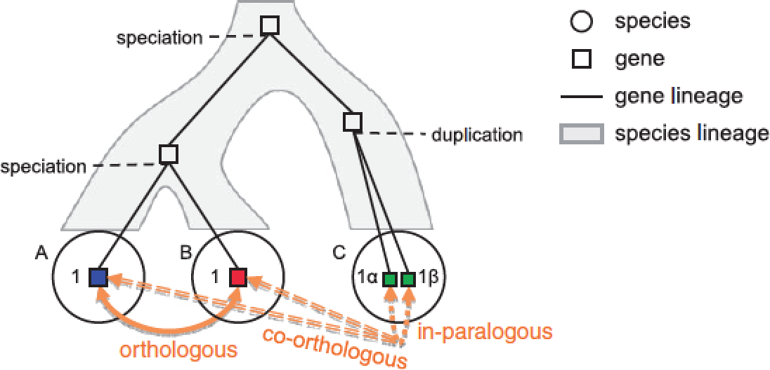
Attack of the –logues
BUT: biology is not well-behaved: relationships can be difficult to infer
Gene loss occurs
Homologues can diverge – sometimes very widely: hard to recognise
Reconstructed evolutionary trees for speciation events may not be robust
Some resources and tools ‘bend’ definitions, e.g. Ensembl Compara and OrthoMCL.
http://www.ensembl.org/info/genome/compara/ homology_method.html
Kristensen et al. (2011) Brief. Bioinf. doi:10.1093/bib/bbr030

Slide 35
Note on “Orthology”
Frequently abused/misused as a term
“Orthology” was defined as an evolutionary relationship, but now often bent into service as a functional descriptor
Strictly defined only for two species or clades!
(cf. cluster definitions OrthoMCL, etc.)
Orthology is not always transitive (A is orthologue of C and B is orthologue of C does not necessarily imply A is an orthologue of B)
Storm & Sonnhammer (2002) Bioinformatics. doi:10.1093/bioinformatics/18.1.92 Jensen (2001) Genome Biol. doi:10.1186/gb-2001-2-8-interactions1002
Fitch (2000) Trends Genet. doi:10.1016/S0168-9525(00)02005-9

Slide 36
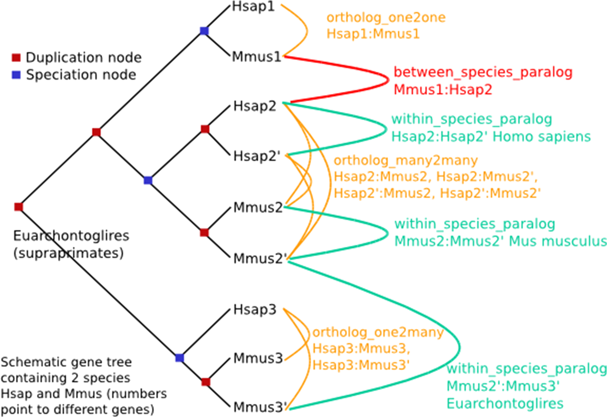
Ensembl Compara definitions
within_species_paralog: same-species paralogue (in-paralogue)
ortholog_one2one: orthologue
ortholog_one2many: orthologue/paralogue relationship
orthology_many2many: orthologue/paralogue relationship
NOTE: taxonomies are not always correct…
Vilella et al. (2009) Genome Res. doi:10.1101/gr.073585.107

Slide 37
Finding “Orthologues”
Or, more pragmatically for hypothesis generation…
Finding evolutionary (and/or functional) equivalents of features across two or more organisms’ genomes.

Slide 38
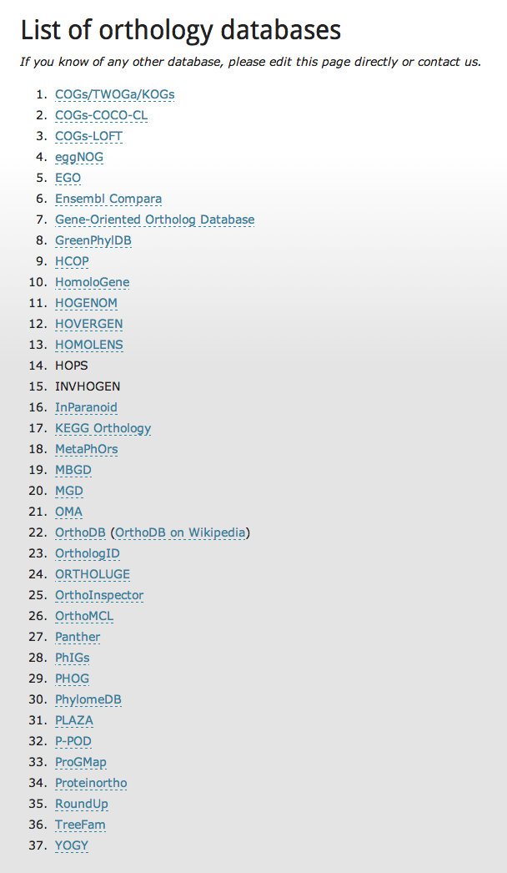
Why “orthologues”?
Need to formalise the concept of corresponding genes across multiple organisms.
Evolutionary
Functional? (“The Ortholog Conjecture”)
Applications in:
Comparative genomics
Functional genomics
Phylogenetics, …
Many (>35) databases attempt to describe orthologous relationships
http://questfororthologs.org/orthology_databases
Dessimoz (2011) Brief. Bioinf. doi:10.1093/bib/bbr057
Chen & Zhang (2012) PLoS Comp. Biol. doi:10.1371/journal.pcbi.1002784
Altenhoff et al. (2012) PLoS Comp. Biol. doi:10.1371/journal.pcbi.1002514

Slide 39
How to find “orthologues”?
Many published methods and databases:
Pairwise between two genomes:
RBBH (aka BBH, RBH, etc.), RSD, InParanoid, RoundUp
Multi-genome:
Graph-based: COG, eggNOG, OrthoDB, OrthoMCL, OMA, MultiParanoid
Tree-based: TreeFam, Ensembl Compara, PhylomeDB, LOFT
Methods may apply different - or refined - definitions of orthology, paralogy, etc.
Salichos et al. (2011) PLoS One. doi:10.1371/journal.pone.0018755
Trachana et al. (2011) Bioessays doi:10.1002/bies.201100062
Kristensen et al. (2011) Brief. Bioinf. doi:10.1093/bib/bbr030

Slide 40
Evaluating “Orthologue” Predictions
Which methods work best? (and what do we even mean by “best”, anyway?)

Slide 41
Evaluating Predictions
Works the same way for all prediction tools
Define a “validation set” (gold standard), unseen by the prediction tool
Make predictions with the tool
Evaluate confusion matrix and performance statistics
Sensitivity
Specificity
Accuracy
Standard: | +ve | -ve
Predict +ve | TP | FP
Predict -ve | FN | TN
False positive rate | FP/(FP+TN)
False negative rate | FN/(TP+FN)
Sensitivity | TP/(TP+FN)
Specificity | TN/(FP+TN)
False discovery rate (FDR) | FP/(FP+TP)
Accuracy | (TP+TN)/(TP+TN+FP+FN)

Slide 42
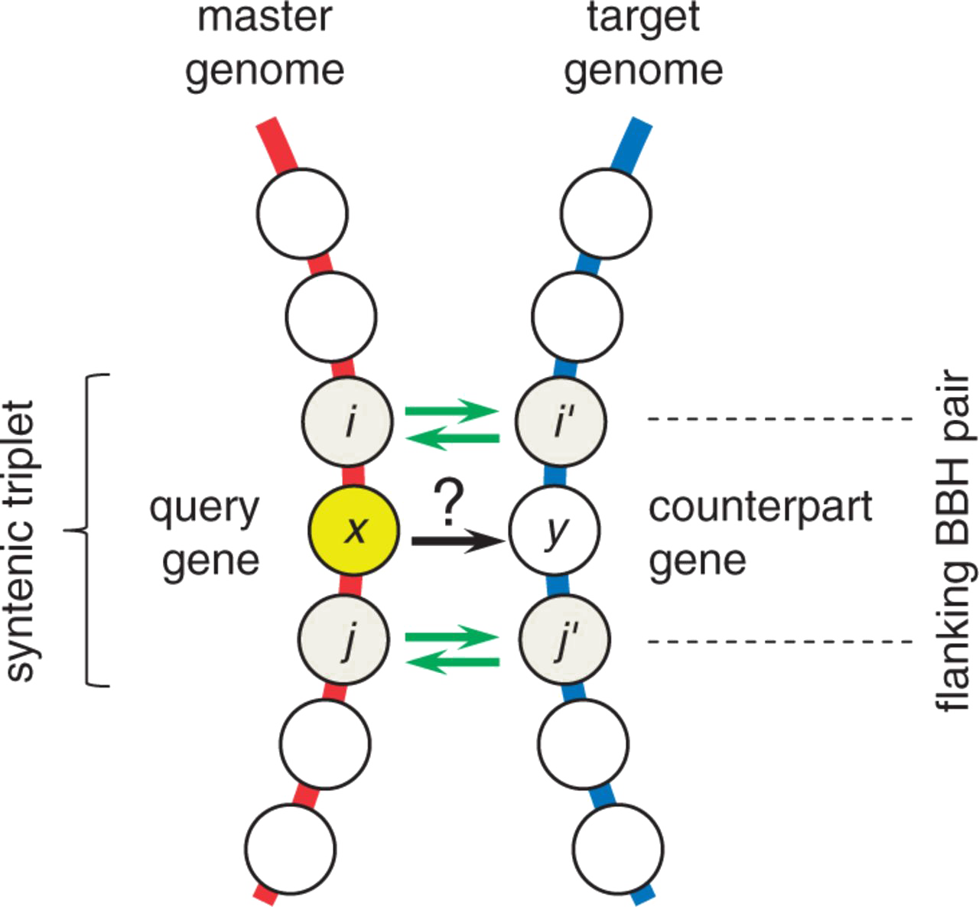
Evaluating “Orthologue” Predictions
Take advantage of prokaryotic operon structure: conserved syntenic triplets likely to be orthologous
Idea: If the outer pair in a syntenic triplet are orthologous, the middle gene is likely to be, too.
Middle genes are orthologue “gold standard”
Do RBBH reliably identify middle genes from syntenic triplets?
Wolf et al. (2012) Genome Biol. Evol. doi:10.1093/gbe/evs100

Slide 43
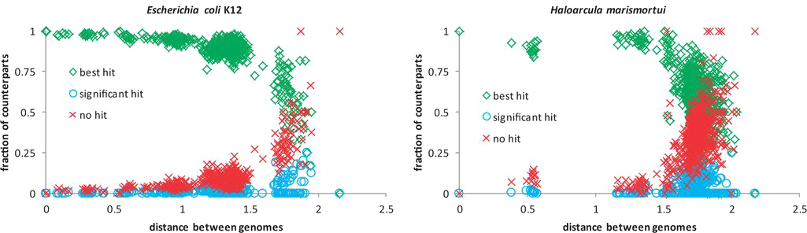
Evaluating “Orthologue” Predictions
Two well-characterised genomes compared against 573 prokaryotes
Identified RBBH (with permissive BLAST settings)
“Overwhelming majority” of middle genes (counterparts) are BBH
88-99% of BBH are in syntenic triplets
Therefore, RBBH reliably finds orthologues
Wolf et al. (2012) Genome Biol. Evol. doi:10.1093/gbe/evs100

Slide 44
Evaluating “Orthologue” Predictions
Four orthologue prediction algorithms:
RBBH (and cRBH)
RSD (and cRSD)
MultiParanoid
OrthoMCL
Tested against 2,723 curated orthologues from six Saccharomycetes
Rated by:
Sensitivity: TP/(TP+FN) – what proportion of orthologues are found
Specificity: TN/(TN+FP) – how well are non-orthologues excluded
Accuracy: (TP+TN)/(TP+TN+FP+FN) – general measure of performance
FDR: FP/(FP+TP) – what proportion of predictions are incorrect
Salichos et al. (2011) PLoS One. doi:10.1371/journal.pone.0018755

Slide 45
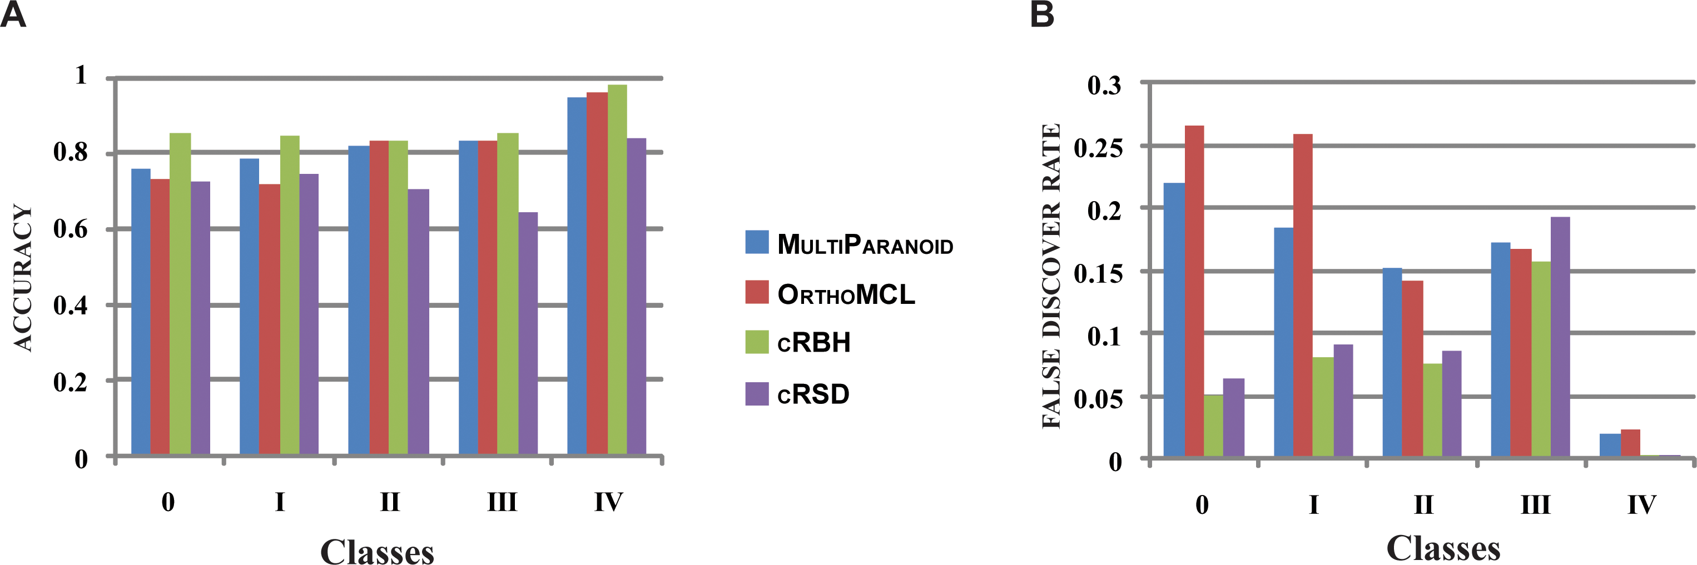
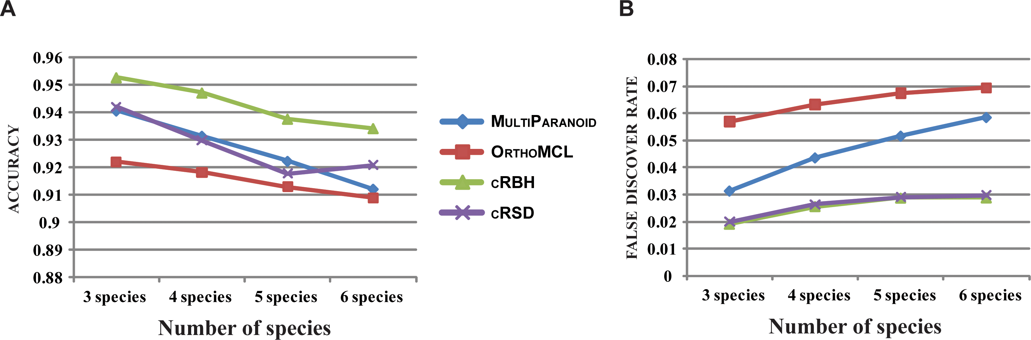
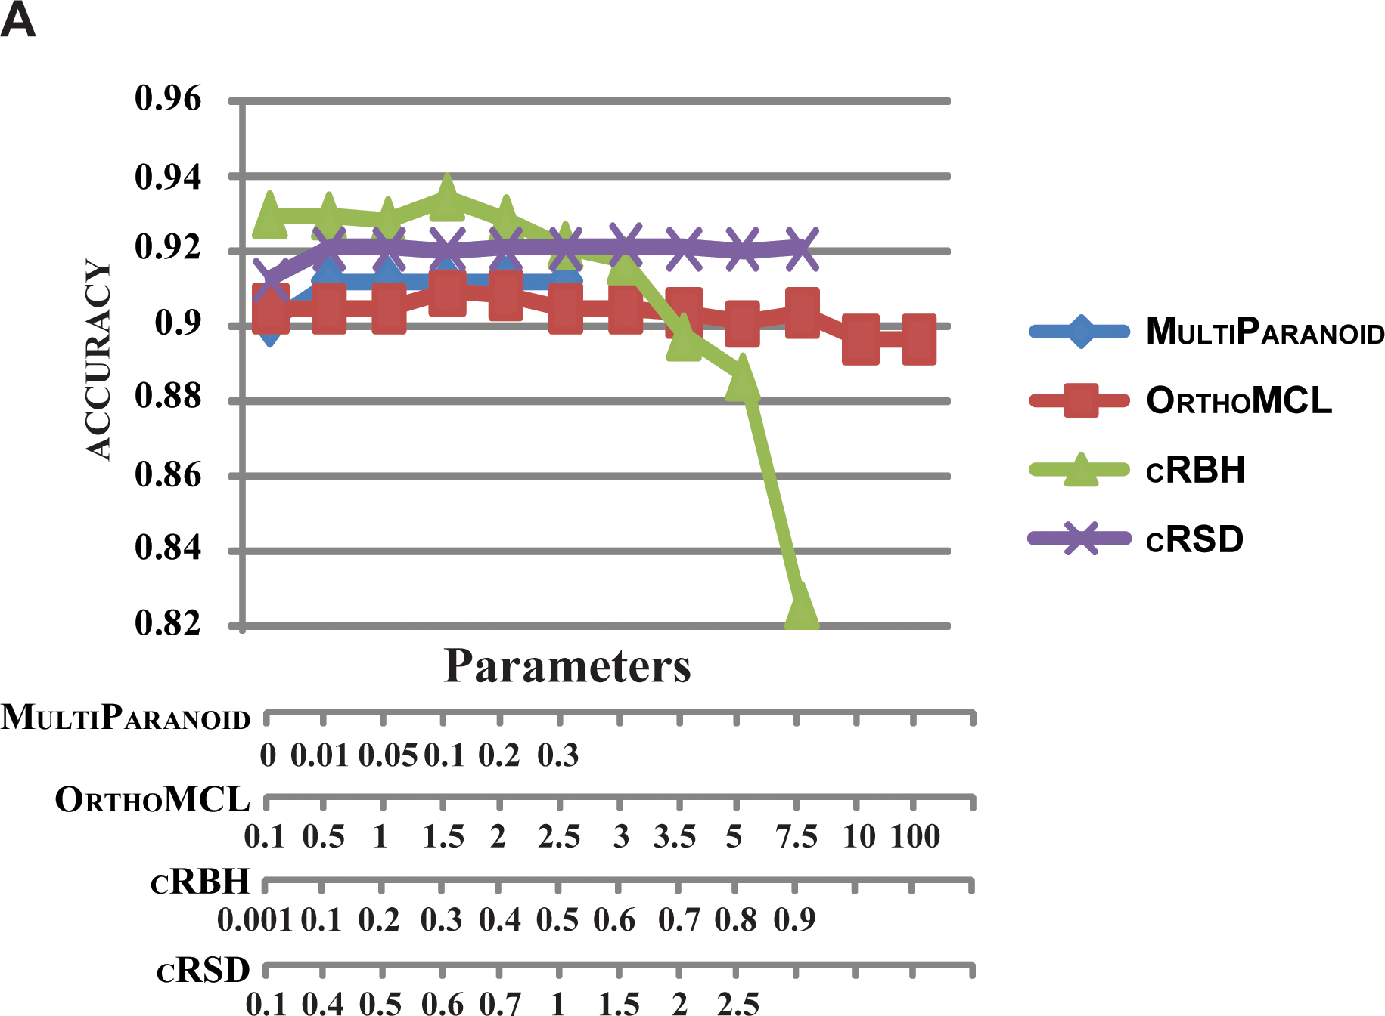
Evaluating “Orthologue” Predictions
Four orthologue prediction algorithms:
RBBH (cRBH)
RSD (cRSD)
MultiParanoid
OrthoMCL
cRBH most accurate, and specific, with lowest FDR
Salichos et al. (2011) PLoS One. doi:10.1371/journal.pone.0018755

Slide 46
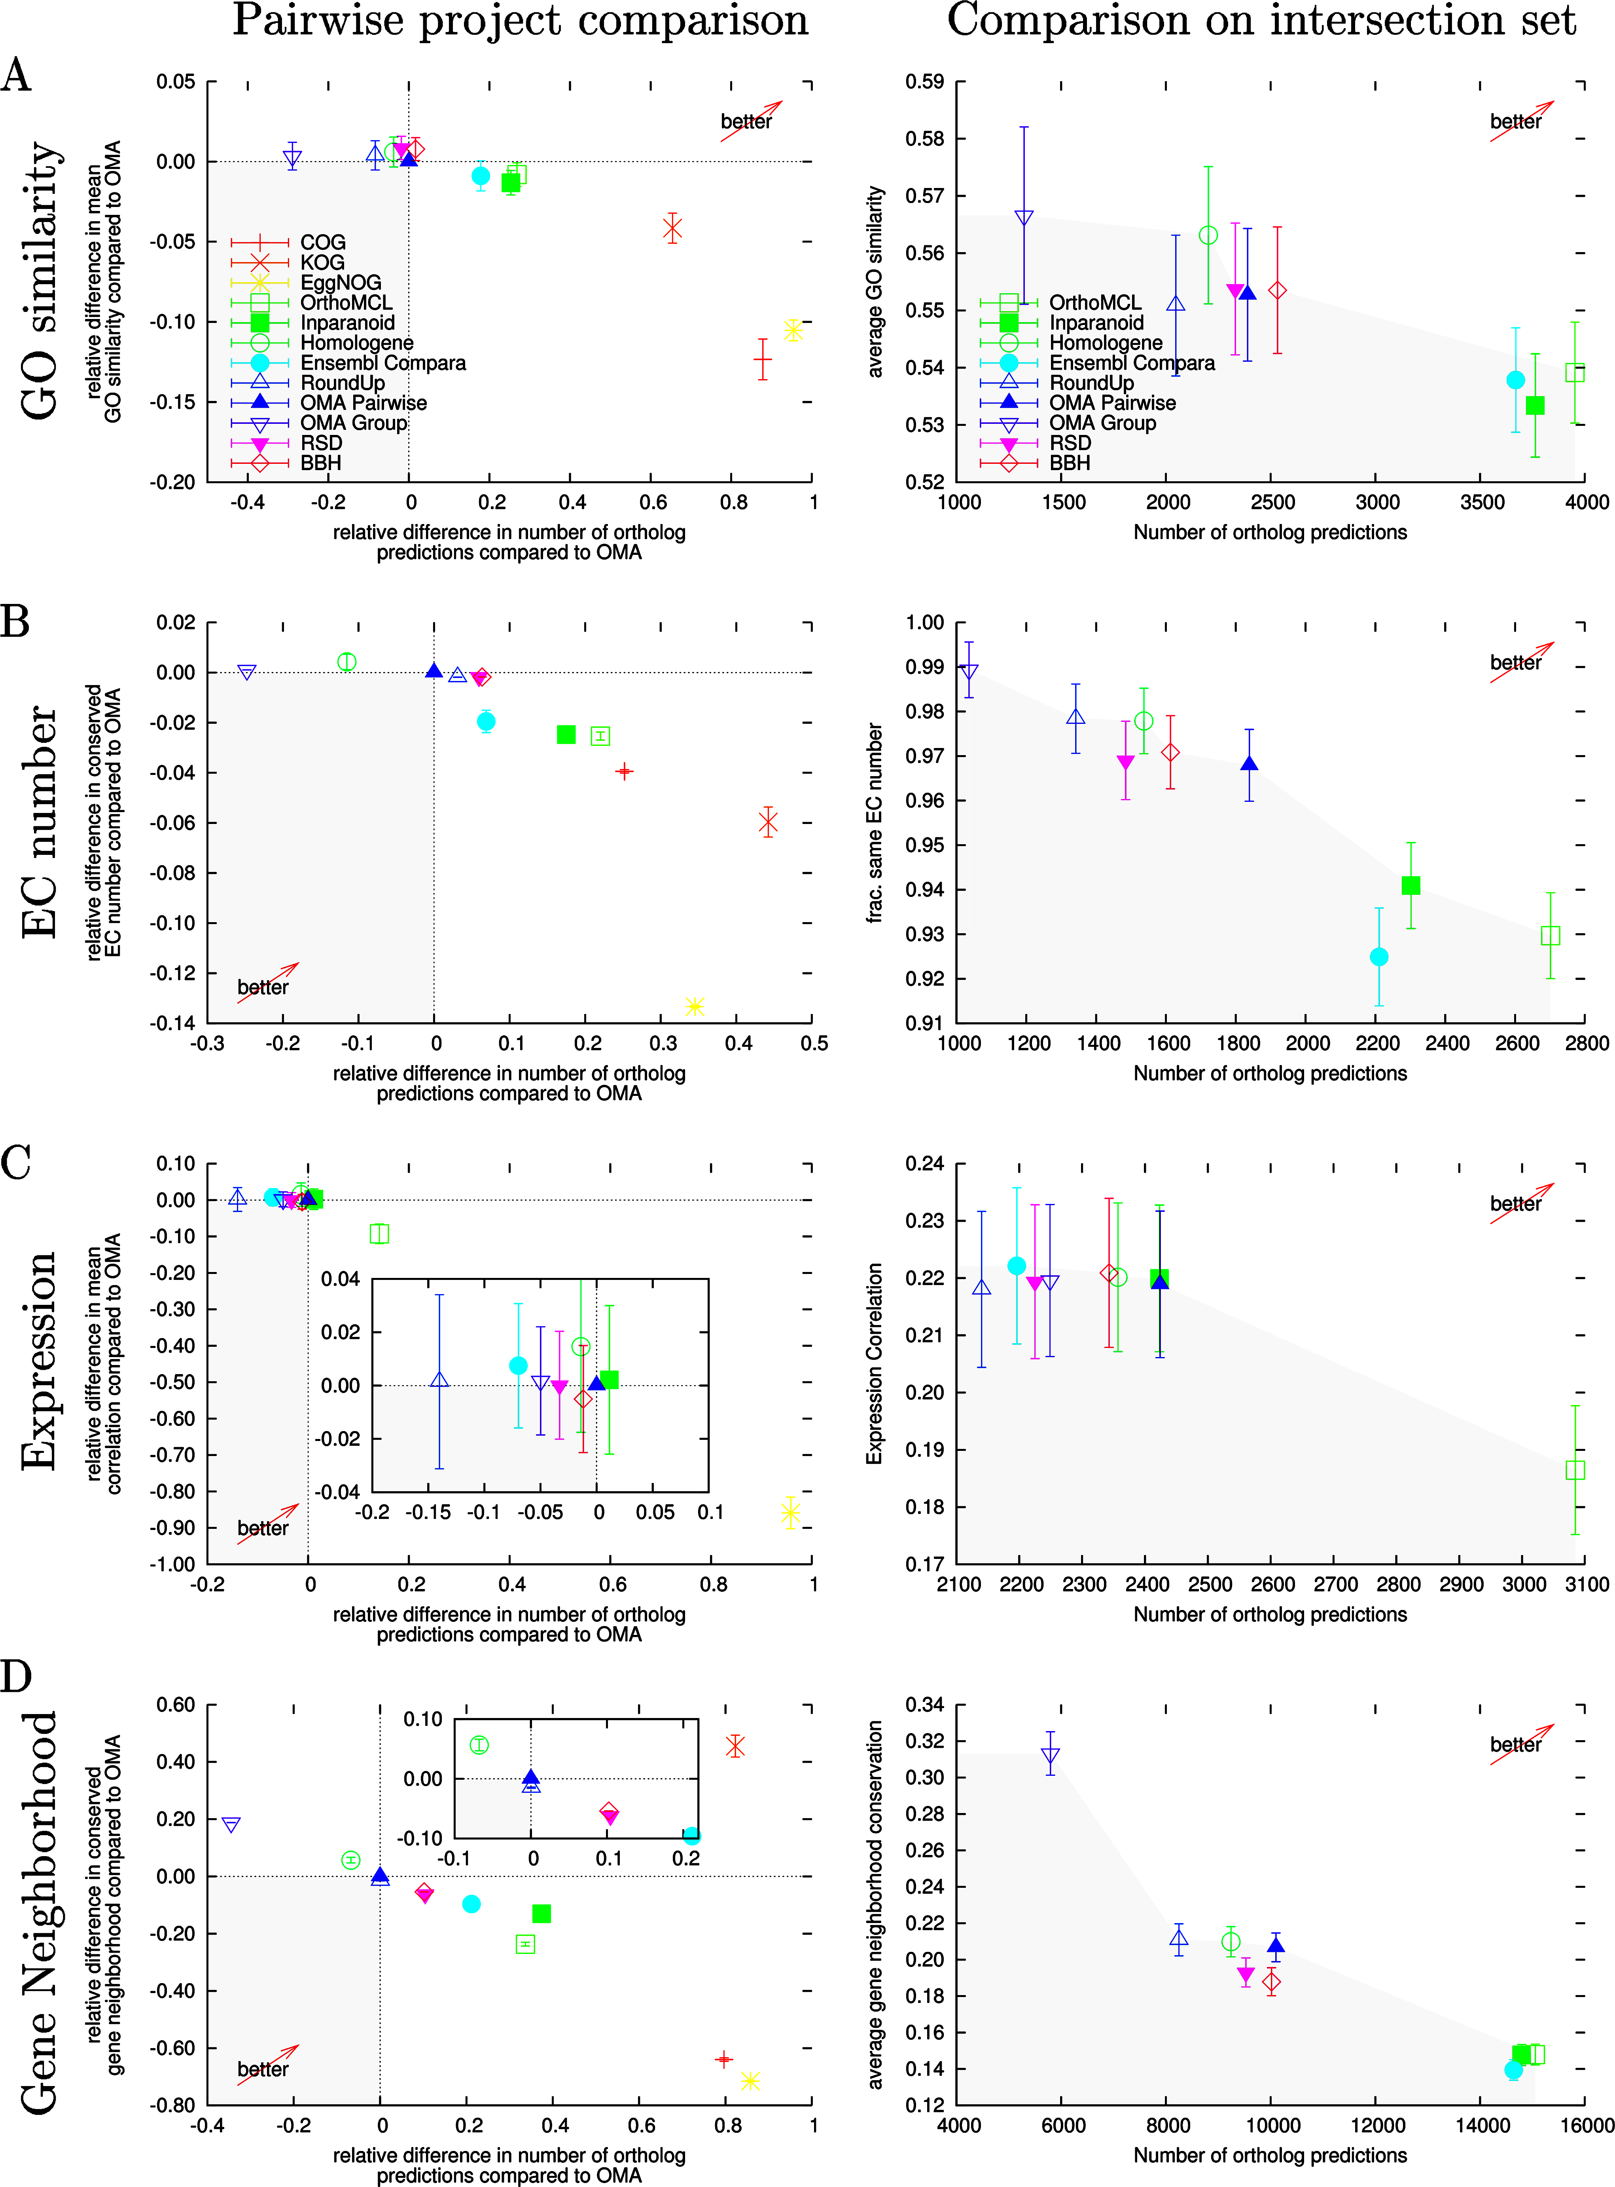
Evaluating “Orthologue” Predictions
Tests of several methods on a number of literature-based benchmarks for:
Correct branching of phylogeny
Grouping by function
GO similarity
EC number
Expression level
Gene Neighbourhood
Altenhoff & Dessimoz (2009) PLoS Comp. Biol. doi:10.1371/journal.pcbi.1000262

Slide 47
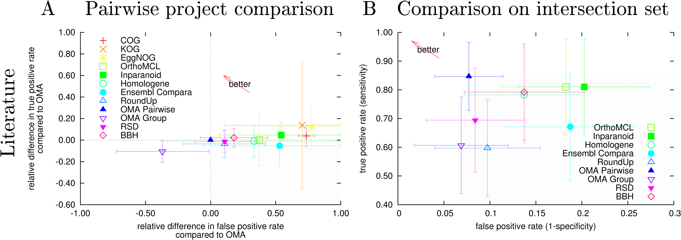
Evaluating Orthologue Predictions
Altenhoff & Dessimoz (2009) PLoS Comp. Biol. doi:10.1371/journal.pcbi.1000262

Slide 48
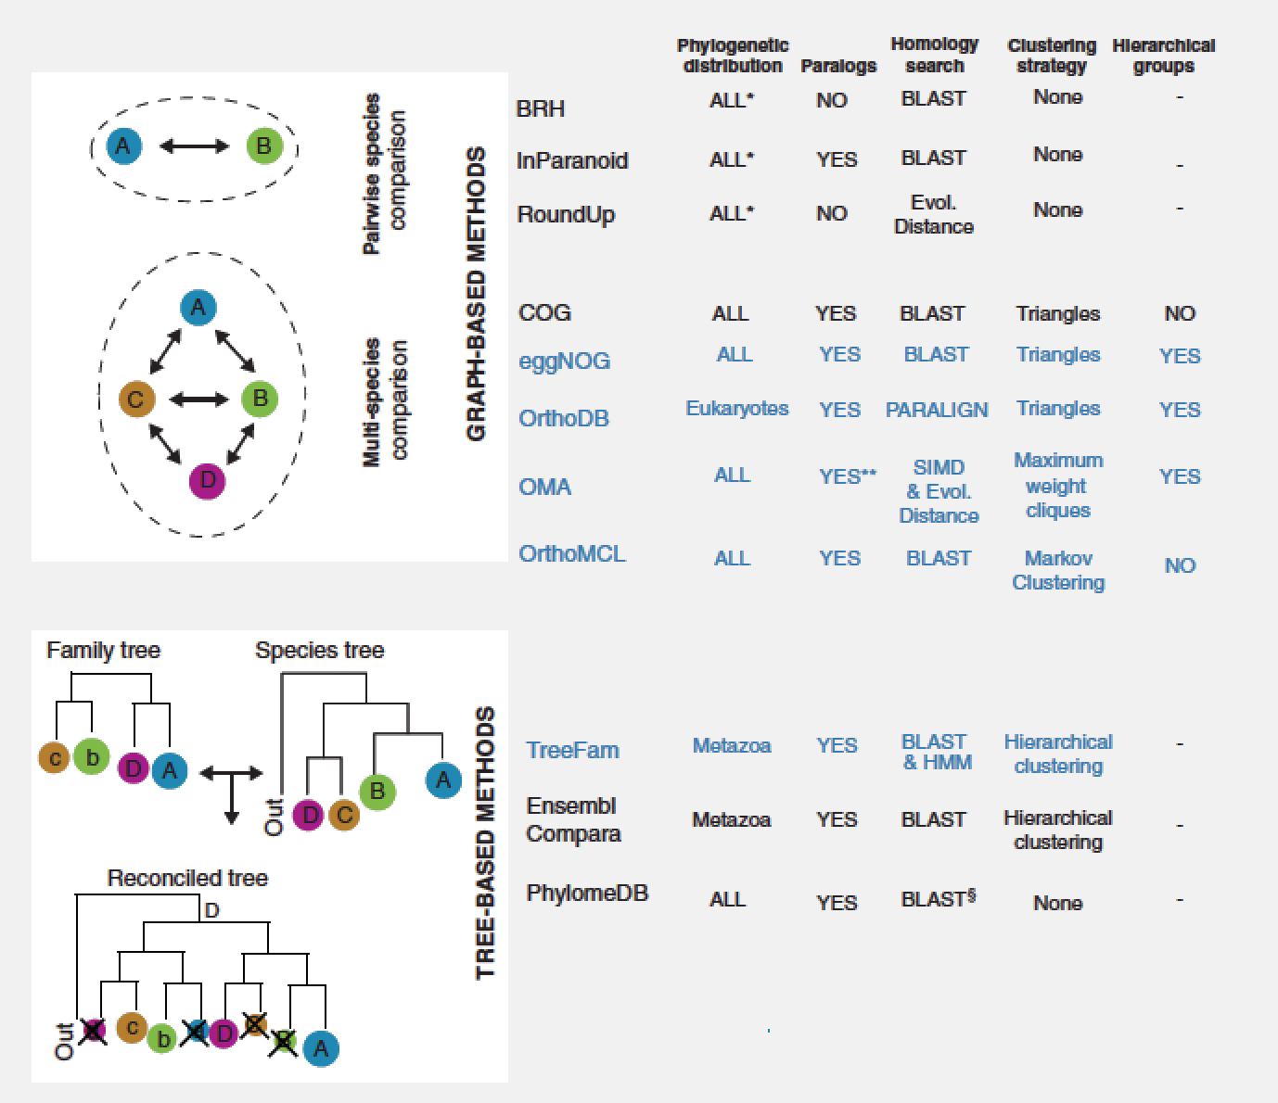
Evaluating “Orthologue” Predictions
70 gene family test, multiple evolutionary scenarios
Tested databases with associated algorithms:
Trachana et al. (2011) Bioessays. doi:10.1002/bies.201100062

Slide 49
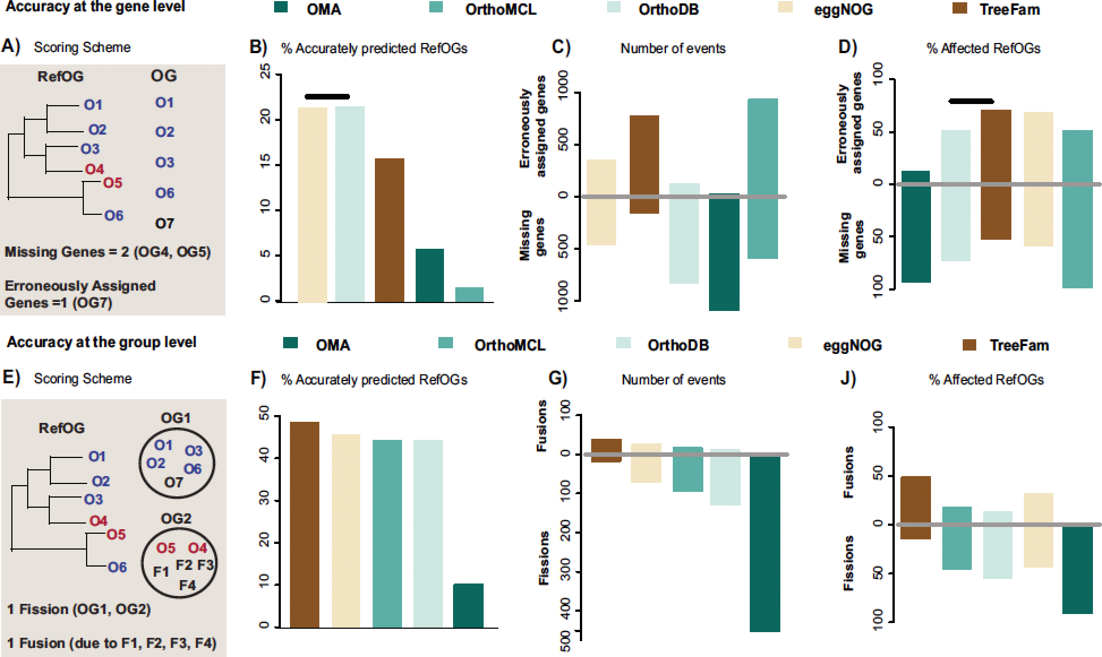
Evaluating “Orthologue” Predictions
70 gene family test set, multiple evolutionary scenarios
All methods/dbs have strong scope for improvement.
OrthoMCL poor performer, TreeFam & eggNOG do best
Trachana et al. (2011) Bioessays. doi:10.1002/bies.201100062

Slide 50
“Orthologue” Prediction Performance
Performance varies by choice of method and interpretation of “orthology”
Biggest influence is genome annotation quality
Relative performance varies with benchmark choice
(clustering) RBH outperforms more complex algorithms under many circumstances
Wolf et al. (2012) Genome Biol. Evol. doi:10.1093/gbe/evs100
Salichos et al. (2011) PLoS One. doi:10.1371/journal.pone.0018755
Altenhoff & Dessimoz (2009) PLoS Comp. Biol. doi:10.1371/journal.pcbi.1000262
Trachana et al. (2011) Bioessays. doi:10.1002/bies.201100062

Slide 51
Pba Questions
What are the gene complement similarities and differences between Pba and:
other enterobacteria?
other plant pathogens?
animal pathogens?
other environmental bacteria?
What is genomic evidence for pathogenicity determinants?
Do pathogenicity determinants show evidence of LGT?
Are there characteristic features of the Pba genome?

Slide 52
Pba Reciprocal Best Hits (RBH)
RBH not truly orthologues, but “equivalent” features
Used FASTA (standard Sanger approach – but bugs)
Compared to 64 completely sequenced bacterial genomes (most of those available at the time, also limited by computing power)
Limited matches to: >30% identity (above “twilight zone”) >80% coverage (exclude domain-only matches)
✔
✘
best hit
G_{S1n}
2nd best hit
G_{S1n}
best hit
G_{S2n}
best hit
G_{S2n}
2nd best hit
best hit
best hit

Slide 53
Pba Reciprocal Best Hits (RBH)
S1, S2 are the gene sequence sets from two organisms
Use sequence search tool (BLAST/FASTA):
Query=S1, Subject=S2
Query=S2, Subject=S1
Optionally filter hits (e.g. on %identity and %coverage)
Find all pairs of sequences {G_{S1n}, G_{S2n}} in S1, S2 where G_{S1n} is the best BLAST match to G_{S2n} and G_{S2n} is the best BLAST match to G_{S1n}.
✔
✘
best hit
G_{S1n}
2nd best hit
G_{S1n}
best hit
G_{S2n}
best hit
G_{S2n}
2nd best hit
best hit
best hit

Slide 54
Pba Reciprocal Best Hits (RBH)
Advantages:
quick
easy
performs surprisingly well
Disadvantages:
1:1 matches miss paralogues
not good at identifying gene families or *-to-many relationships without more detailed analysis.
no strong theoretical/phylogenetic basis.

Slide 55
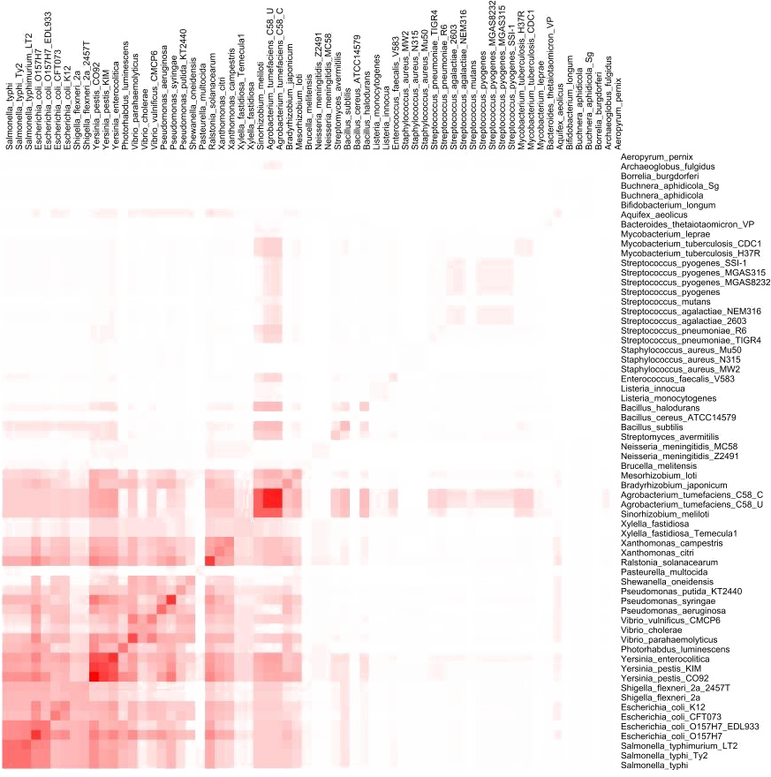
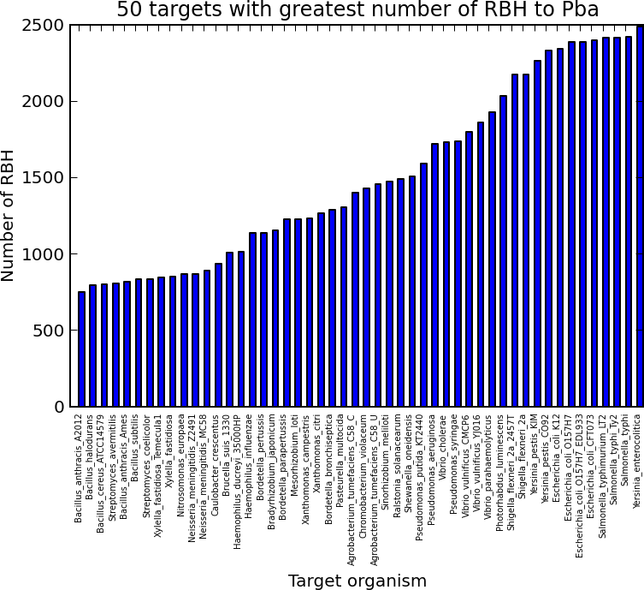
Pba Reciprocal Best Hits (RBH)
Most RBH with other enterobacteria (see pba_rbh.ipynb)
Pathogenicity factors also shared with plant-associated non- enterobacterial genomes

Slide 56
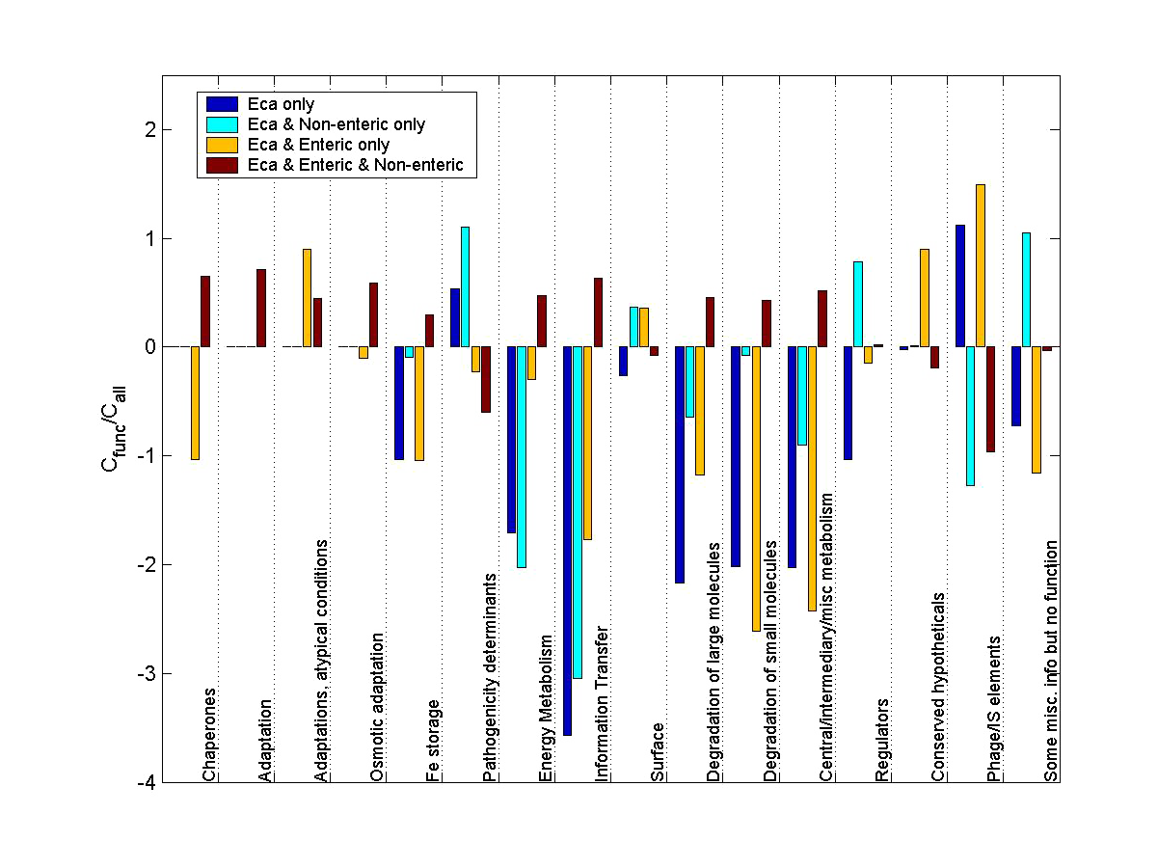
Functional Classification
Compare frequency of functional classifications in Pba and other organism classes (NOTE: annotation-dependent)
Test statistically for enrichment/overrepresentation
Many, many methods & programs for this (68 tools summarised in 2009 review)
Pba-specific:
Pathogenicity determinants
Phage/IS elements
Pba & non-enteric (LGT?)
Pathogenicity determinants
Surface proteins
Regulatory proteins
Huang et al. (2009) Nucleic Acids Res. doi:10.1093/nar/gkn923.

Slide 57
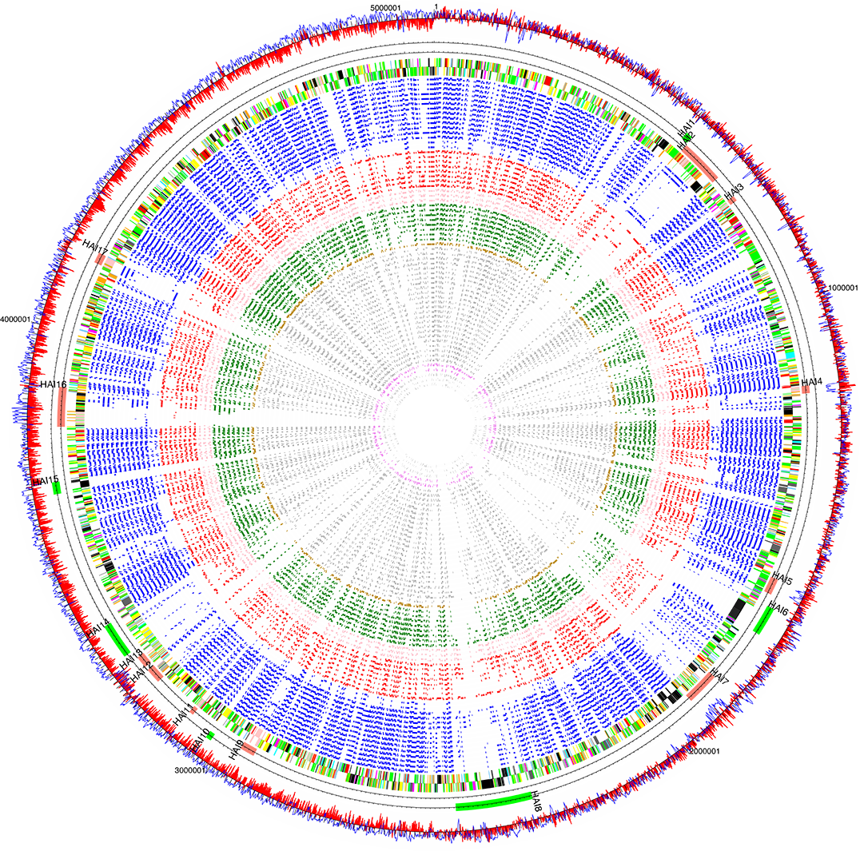
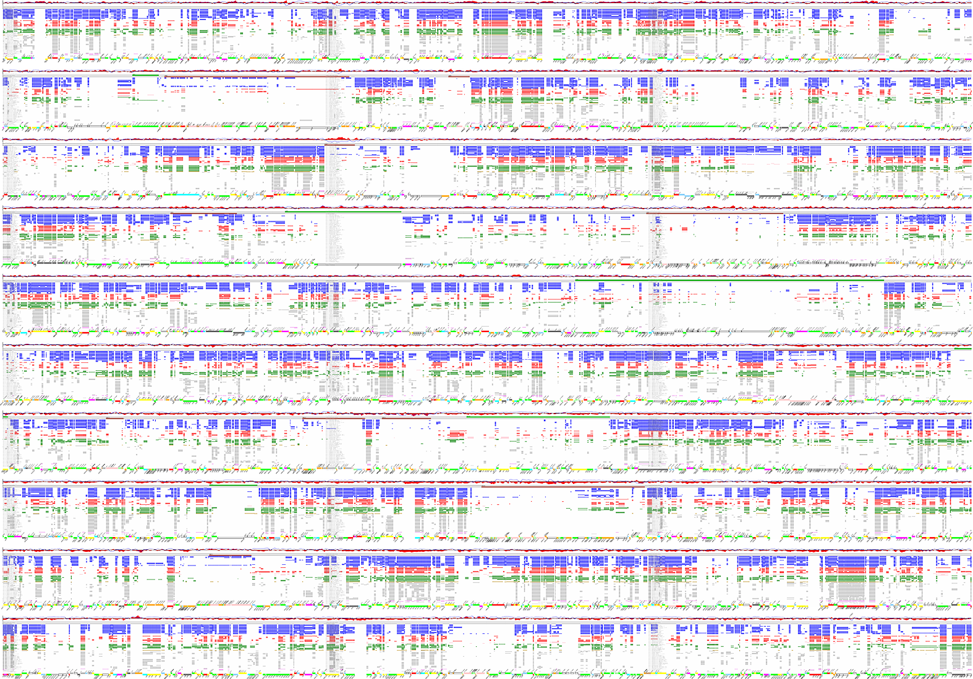
Pba RBH Visualisation
114,087 RBH between Pba and target bacteria too much to go through by hand/eye
Visualisation tools were essential

Slide 58

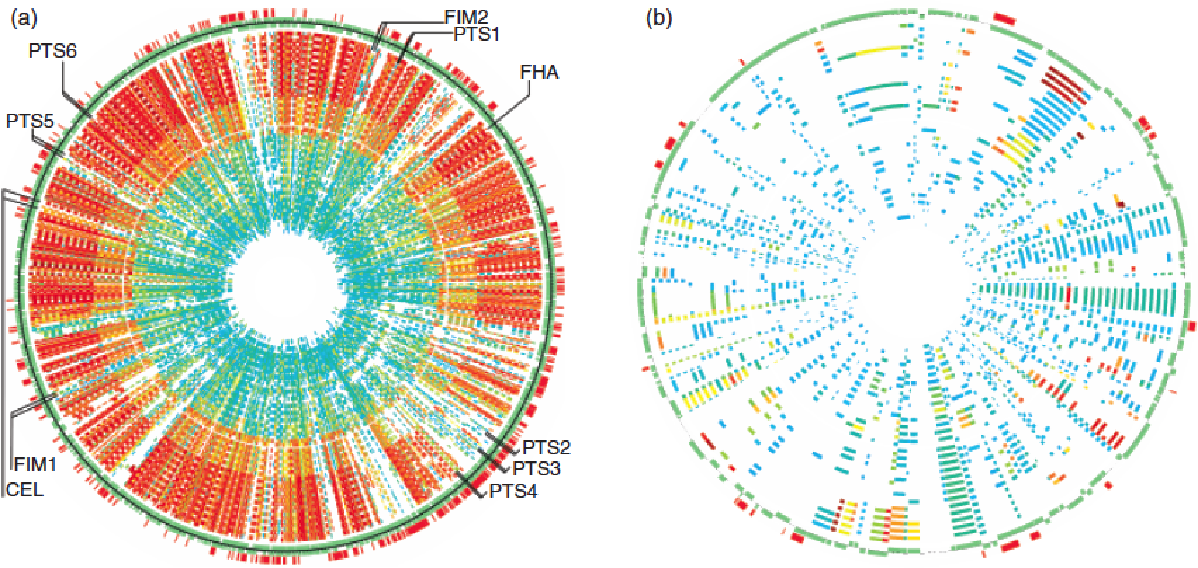
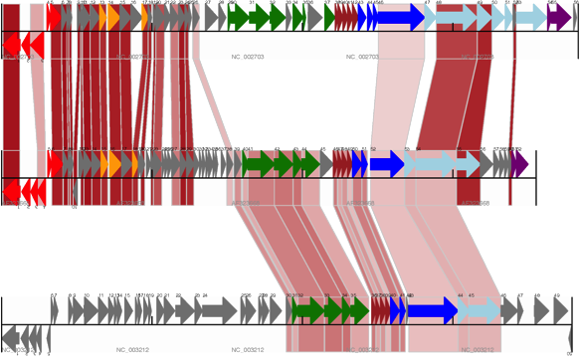
GenomeDiagram
Comparative genomics visualisation package
Developed in 2003 for Pba sequencing, later incorporated into Biopython
http://www.biopython.org
Pritchard et al. (2006) Bioinformatics doi:10.1093/bioinformatics/btk021.

Slide 59
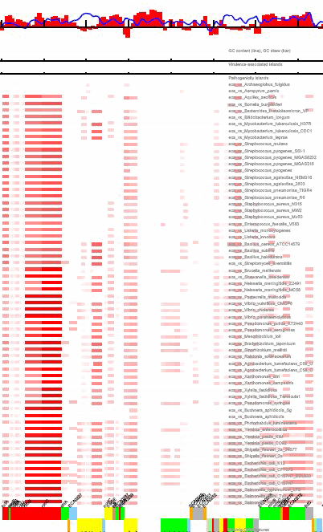
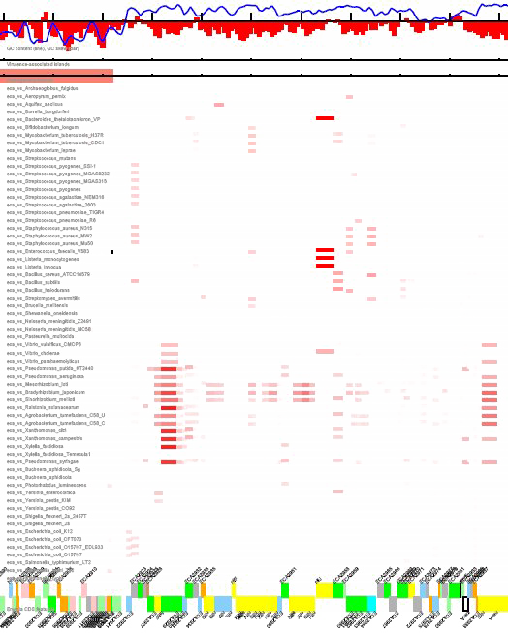
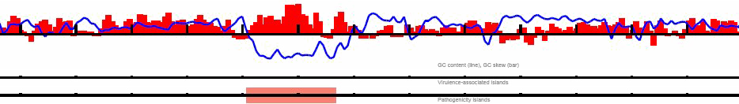

Visualising LGT in Pba
Looked for CDS where RBH sequence similarity doesn’t follow the taxonomic species tree, and GC% anomalies
Colour sequence similarity: more red = more similar

Slide 60
Pba LGT
Initially, 11 putative horizontally-acquired islands (HAIs) identified by atypical G+C, proximity of tRNA, etc.
Six further putative HAIs identified on the basis of RBH (may be more ancient acquisitions)
HAI8: Type III Secretion System, Pseudomonas syringae
HAI2: Phytotoxin (cfa) synthesis, P. syringae
HAI15: Adherence/agglutination, Vibrio spp.
HAI14: Nitrogen fixation, Bradyrhizobium spp.

Slide 61

Pba LGT: Plant-associated bacteria
2006: Two years later, far more genomes (400) for comparison
Larger selection of plant- and animal-associated bacteria

Slide 62

Pba LGT: Plant-associated bacteria
Comparison against plant- (13) and animal-associated (14) bacteria
Plant-associated in centre
Animal-associated on outside
Red marks: greater similarity to plant-associated bacteria
HAI2: Phytotoxin
HAI15: Adherence
HAI14: Nitrogen fixation
HAI8: T3SS
Toth et al. (2006) Ann. Rev. Phytopathol. doi:10.1146/annurev.phyto.44.070505.143444

Slide 63

SPI-7 and Coronafacic Acid
Coronatine (P. syringae) interferes with jasmonate responses in host, as a jasmonate mimic
Coronafacic acid –
Pseudomonas syringae
phytotoxin precursor
(coronatine)
- payload
SPI-7 -
Salmonella Typhi
Pathogenicity island
delivery system
coronafacic acid: cfl, cfa7
SPI-7, Salmonella
Block et al. (2005) Mol. Plant Pathol. doi:10.1111/j.1364-3703.2004.00265.x.
Toth et al. (2006) Ann. Rev. Phytopathol. doi:10.1146/annurev.phyto.44.070505.143444

Slide 64



Coronafacic Acid Synthesis
Present in Pba, some Pcc, virtually no Dickeya
cfl and cfa7 knockouts show reduced Pba virulence
200cfu inoculation, measure 17dpi
WT
cfl::mTn5
cfa7::mTn5
Slawiak & Lojkowska (2009) Eur. J. Plant Pathol. doi:10.1007/s10658-008-9418-7.

Slide 65




Science/Art Collaboration
Collaboration with Elaine Shemilt (Duncan of Jordanstone)
Audio-visual installation, screenprints
Music derived from genome sequence (automated, then compositions by Genevieve Murphy)
Exhibited in Scotland and Singapore
http://www.dundee.ac.uk/djcad/research/researchprojectscentresandgroups/blueprint/
http://www.chart.ac.uk/chart2006/papers/shemilt.htm
http://sgmuseum.gs/elaine/blueprintDigVis.pdf
Shemilt (2009) in “Digital Visual Culture: Theory and Practice” ISBN 978-1-84150-248-9
Shemilt (2010) in “Art Practice in a Digital Culture”, ISBN 978-0-7546-7623-2

Slide 66
Conclusions I
Comparative genomics is powerful!
Good annotation is essential to understanding genomic data
Useful, falsifiable hypotheses can be generated from inspection of genomic data
Visualisation is extremely useful for large genomic datasets
Determining orthology/functional equivalence on large scale data is not yet a solved problem

Slide 67



2009: Phytophthora infestans
Haas et al. (2009) Nature 461: 393-398. doi:10.1038/nature08358.

Slide 68


Phytophthora infestans
The most destructive pathogen of potato ($6.7bn/yr)
Causes potato late blight
Irish Potato Famine (1850s)
Oomycete model organism, hemibiotrophic
Adapts rapidly to overcome control measures and bred resistance

Slide 69
Phytopthora infestans
Major international collaboration, 34 institutions
WGS at Broad Institute of MIT and Harvard, to 9X coverage
Four library types, due to highly repetitive genome
4kb plasmids, 10kb plasmids, 40kb fosmids, 80kb BACs
Annotation mostly automated; some protein families received manual review by the community
CRN, NPP1-like, elicitin-like, small secreted cysteine-rich, RxLR and transporter
Published 2009, Nature (96 authors) Haas et al. (2009) Nature 461: 393-398. doi:10.1038/nature08358.
Public data: 18,288 contigs (4,921 supercontigs); 250Mbp (possibly triploid) http://www.broadinstitute.org/annotation/genome/phytophthora_infestans

Slide 70
Effector Protein Analysis
Pathogen
Effector in transit:
Active effector:
Export
Injection
e.g. Type III secretion
e.g. protease inhibitors (block plant defence)
Import
Plant host
Host nucleus
e.g. transcriptional regulators
Localisation
Golgi

Slide 71

P. infestans Avr3a locus
Contigged, annotated
P. infestans and
H. peronospora BAC
fragments
Identified microsynteny
surrounding the Avr3a
and ATR1 avirulence
loci
Avr3a, ATR1 belong to
RXLR family
RXLR N-terminal motif observed in a number of P. infestans effectors
Also observed in Plasmodium falciparum, and thought associated with translocation
Necessary for translocation in P. infestans
Armstrong et al. (2005) Proc. Natl. Acad. Sci. USA doi:10.1073/pnas.0500113102
Whisson et al. (2007) Nature doi:10.1038/nature06203

Slide 72

Genome expansion in oomycetes
Early evidence from BAC assemblies of syntenous loci
H. parasitica
P. sojae
P. ramorum
P. infestans
Armstrong et al. (2005) Proc. Natl. Acad. Sci. USA doi:10.1073/pnas.0500113102
Whisson et al. (2007) Nature doi:10.1038/nature06203

Slide 73

Repeat-driven Genome Expansion
P. infestans genome >70% repeat regions
“Our findings suggest a two-speed genome…” https://www.broadinstitute.org/news/1328
High repeat density results in ‘experimentation’
repeats
collinear gene features
Haas et al. (2009) Nature doi:10.1038/nature08358

Slide 74

P. infestans two-speed genome
Diverse population of transposons drives genome expansion specifically in P. infestans
Pathogen effectors disproportionately located in expansion regions
Expansion drives effector diversity, drives adaptation to new resistances?
(see pi_two_speed.ipynb)
Haas et al. (2009) Nature doi:10.1038/nature08358

Slide 75
Effector Properties: action and localisation
Pathogen
Effector in transit:
Active effector:
Export
Injection
e.g. Type III secretion
e.g. protease inhibitors (block plant defence)
Import
Plant host
Host nucleus
e.g. transcriptional regulators
Localisation
Golgi

Slide 76
What is an effector?
Molecule produced by pathogen that (directly?) modifies host molecular/biochemical ‘behaviour’, e.g.
Inhibits enzyme action (Cladosporium fulvum AVR2, AVR4; Phytophthora infestans EPIC1, EPIC2B; P. sojae glucanase inhibitors)
Cleaves protein target (Pseudomonas syringae AvrRpt2)
(De-)phosphorylates protein target (Pseudomonas syringae AvrRPM1, AvrB)
Additional component in/retargeting host system, e.g. E3 ligase activity (P. syringae AvrPtoB; P. infestans Avr3a)
Regulatory control (Xanthomonas campestris AvrBs3, TAL effectors)

Slide 77


What is an effector?
No unifying biochemical mechanism; may act inside or outwith host cell, many functions and final locations
No single test for ‘candidate effectors’
Tests are for protein family membership and/or evidence of ‘effector-like behaviour’
A general sequence classification problem (functional annotation)
Many possible bioinformatic/computational approaches
No big red button

Slide 78


Characteristics of known effectors
Modularity
Delivery: localisation/translocation domain(s)
Activity: functional/interaction domain(s)
Greenberg & Vinatzer (2003) Curr Opin Microbiol doi:10.1016/S1369-5274(02)00004-8
Collmer et al. (2002) Trends in Microbiology doi:10.1016/S0966-842X(02)02451-4

Slide 79


Characteristics of known effectors
Modularity
Delivery: localisation/translocation domain(s)
Activity: functional/interaction domain(s)
Dong et al. (2011) PLoS One doi:10.1371/journal.pone.0020172. Bouwmeester et al. (2011) Front. Plant-Microbe Int. doi:10.3389/fpls.2011.00075

Slide 80

Characteristics of known effectors
Sequence motifs
Localisation/translocation domain(s) typically common to effector class (e.g. RxLR, T3E, CHxC)
Functional domain(s) may be common to effector class (e.g. TAL), or divergent (e.g. RxLR, T3E in general)
Boch et al. (2009) Science doi:10.1126/science.1178811.

Slide 81

Characteristics of known effectors
“Arms Races” occur:
Host defences track effector evolution
Effectors evade host defences
Divergence of effectors under selection pressure
Diversifying selection; divergence may result from evasion of detection, rather than change of biochemical ‘function’
Effectors may be found preferentially in characteristic locations
P. infestans ‘gene sparse’ regions
Raffaele et al. (2010) BMC Genomics doi:10.1186/1471-2164-11-637.

Slide 82

Characteristics of known effectors
Application of ‘filters’: reduce the number of sequences to check (similar to stratification)
Presence/absence filters:
SignalP (export signal)
RxLR/T3SS (translocation signal)
Expression (used by pathogen)
Positive selection (suggests arms race)
Location in repeat-rich regions
etc…
Workflows (e.g. Galaxy, Taverna) can be useful here
Fabro et al. (2011) PLoS Pathog. doi:10.1371/journal.ppat.1002348.
Cock et al. (2013) PeerJ doi:10.7717/peerj.167/.
Cock & Pritchard (2014) Methods Mol. Biol. doi:10.1007/978-1-62703-986-4_1
Pritchard & Broadhurst (2014) Methods Mol. Biol. doi:10.1007/978-1-62703-986-4_4

Slide 83


Galaxy Workflow – Effector finding
Public Galaxy workflow for RxLR-finding
http://toolshed.g2.bx.psu.edu/repository?repository_id=0984925f74bd671c
Pc
Ps
Pr
Cock et al. (2013) PeerJ doi:10.7717/peerj.167/.
Cock & Pritchard (2014) Methods Mol. Biol. doi:10.1007/978-1-62703-986-4_1

Slide 84
Sequence space
Known exemplars: red

Slide 85
Sequence space
Define a centre, and a distance that includes the examples

Slide 86
Sequence space
Classify ‘similar’ sequences
Notes:
Then we define anything within this area as belonging to the class.

Slide 87

Finding effectors
Finding effectors is simple(-ish):
Have one or more examples of your effector (class)
Define some kind of appropriate threshold of similarity
Check all the gene/gene product sequences in the genome against that threshold
Pritchard & Broadhurst (2014) Methods Mol. Biol. doi:10.1007/978-1-62703-986-4_4

Slide 88
It’s not that simple
How do we define ‘distance’?
How large a ‘distance’ do we take?
How do we know we’ve chosen a sensible ‘distance’?
Pritchard & Broadhurst (2014) Methods Mol. Biol. doi:10.1007/978-1-62703-986-4_4

Slide 89
How do we define ‘distance’
Sequence identity
Derived score (based on sequence identity/alignment)
Bit score in BLAST
E-value in BLAST
Derived score (based on other measures)
Bit score in HMMer
Clustering (not strictly a distance)
Sequence identity (e.g. CD-HIT)
MCL
(we’re really assessing criteria for class membership)

Slide 90
How large a distance do we take?
Confusion matrix:
 | IN | OUT
Red | 1 | 5
Blue | 1 | 36
Our distance/boundary classifies sequences as ‘in’ or ‘out’
‘red’ or ‘blue’
Changing distance/bound results in various degrees of success…

Slide 91
How large a distance do we take?
True positive
False negative
 | IN | OUT
Red | 1 | 5
Blue | 1 | 36
False positive
True negative
Our distance/boundary classifies sequences as ‘in’ or ‘out’
‘red’ or ‘blue’
Changing distance/bound results in various degrees of success…

Slide 92
How large a distance do we take?
 | IN | OUT
Red | 1 | 5
Blue | 1 | 36
False positive rate | FP/(FP+TN)
False negative rate | FN/(TP+FN)
Sensitivity | TP/(TP+FN)
Specificity | TN/(FP+TN)
False discovery rate | FP/(FP+TP)
Our distance/boundary classifies sequences as ‘in’ or ‘out’
‘red’ or ‘blue’
Changing distance/bound results in various degrees of success…

Slide 93
How large a distance do we take?
 | IN | OUT
Red | 1 | 5
Blue | 1 | 36
False positive rate | 1/37 = 0.03
False negative rate | 5/6 = 0.83
Sensitivity | 1/6 = 0.17
Specificity | 36/37 = 0.97
Our distance/boundary classifies sequences as ‘in’ or ‘out’
‘red’ or ‘blue’
Changing distance/bound results in various degrees of success…

Slide 94
How large a distance do we take?
 | IN | OUT
Red | 5 | 2
Blue | 4 | 33
False positive rate | 0.11
False negative rate | 0.29
Sensitivity | 0.81
Specificity | 0.89
Our distance/boundary classifies sequences as ‘in’ or ‘out’
‘red’ or ‘blue’
Changing distance/bound results in various degrees of success…

Slide 95
How large a distance do we take?
 | IN | OUT
Red | 7 | 0
Blue | 14 | 23
False positive rate | 0.38
False negative rate | 0
Sensitivity | 1
Specificity | 0.62
Our distance/boundary classifies sequences as ‘in’ or ‘out’
‘red’ or ‘blue’
Changing distance/bound results in various degrees of success…

Slide 96
How large a distance do we allow?
Assign known ‘positive’ and ‘negative’ examples
Vary distances and measure performance (F-measure, AUC, …)
Choose distance that gives the best performance
Pritchard & Broadhurst (2014) Methods Mol. Biol. doi:10.1007/978-1-62703-986-4_4

Slide 97
Cross-validation
Estimation of classifier performance depends on
distance measure
composition of training set (‘positives’ and ‘negatives’)
Cross-validation gives objective measure of performance
Many strategies available, including:
leave-one-out (LOO)
k-fold crossvalidation
repeated (random) subsampling
Essentially: always keep a hold-out set (not used to train)
Pritchard & Broadhurst (2014) Methods Mol. Biol. doi:10.1007/978-1-62703-986-4_4

Slide 98
After Cross-validation
False positive rate | 0.11
False negative rate | 0.29
Sensitivity | 0.81
Specificity | 0.89
Precision | 0.56
Used crossvalidation to find ‘best’ method & parameters
This gives estimated performance metrics on unseen data
Apply ‘best’ method to complete dataset for prediction
Pritchard & Broadhurst (2014) Methods Mol. Biol. doi:10.1007/978-1-62703-986-4_4

Slide 99

Building an RxLR training set
Starting point: 49 candidate sequences (reference set)
Known:
Contain (putatively) RxLR-EER motif
All but one transcribed (i.e. not bad gene calls)
Assumed:
Presence of signal peptide and RxLR-EER categorises effectors

Slide 100

Building an RxLR training set
SignalP 3.0 to predict locations of signal peptides.
SignalP also has statistical performance estimates:
Settings:
HMM cutoff probability = 0.9
Cleavage site between positions 10 and 40 inclusive
Justification: use in previous studies by others

Slide 101

Building an RxLR training set
Of 49 candidates, four sequences failed
One carried forward on experimental grounds (highly-expressed)
Training set now has 46 sequences
But seven of these actually have no recognisable RxLR-EER motif, so are discarded
Training set now has 39 sequences
Whisson et al. (2007) Nature doi:10.1038/nature06203
Haas et al. (2009) Nature doi:10.1038/nature08358

Slide 102

Building a classifier
We have a recognisable motif, with substantial local variation and indels
Therefore chose profile HMM
Use HMMer software
Profile HMMs sensitive to quality of alignment
Therefore treat alignment as a parameter of the HMM (much difference between alignments – several tested!)
Whisson et al. (2007) Nature doi:10.1038/nature06203
Haas et al. (2009) Nature doi:10.1038/nature08358

Slide 103
Building a classifier
Parameters modified for HMM
Alignment package (no alignment, anchored, Clustal, DiAlign, T-Coffee) on default settings
Full-length and truncated (no signal peptide) alignments to test for influence of signal peptide region on classifier
Plus one alignment of RxLR-EER plus flanking region only (‘cropped’)
HMM built for each of eleven alignments
Default parameters
Once built, the HMM is the classifier.
hmmbuild --amino <output> <alignment>
Whisson et al. (2007) Nature doi:10.1038/nature06203
Haas et al. (2009) Nature doi:10.1038/nature08358

Slide 104
Testing the classifiers
Only positive examples in training set:
How well does a classifier cover them?

Slide 105

Testing the classifiers
Eleven classifiers to test
Step 1: Consistency test
Does the classifier correctly call as positive the sequences used to train it?
Estimates recovery of the information in the training set
Step 2: Recovery of full sequences
Estimates performance of classifier on complete sequence data
SigP-RxLR-Cterm
RxLR-Cterm
RxLR
Whisson et al. (2007) Nature doi:10.1038/nature06203
Haas et al. (2009) Nature doi:10.1038/nature08358

Slide 106
Testing the classifiers
Only positive examples:
How well does a classifier recover unseen sequence?

Slide 107
Testing the classifiers
Only positive examples:
How well does a classifier recover unseen sequence?

Slide 108
Testing the classifiers
Leave-one-out (LOO) crossvalidation:
k runs, each with one training set, one test set (n items in dataset, k=n)
run1
run2
…
runk
Training Set
Test Set

Slide 109

Testing the classifiers
Step 3: Leave-One-Out Crossvalidation
But only have positive examples!
Removes possibility that classifier matches on basis of having ‘seen’ a sequence before
Better match to classifier than to control
SigP- RxLR- Cterm
RxLR- Cterm
RxLR
Whisson et al. (2007) Nature doi:10.1038/nature06203
Haas et al. (2009) Nature doi:10.1038/nature08358

Slide 110
Testing the classifiers
Step 4: Tests on negative samples
Completely shuffled sequences
Shuffled downstream of the signal peptide only
Replace RxLR-EER with AAAA-AAA
No classifier identifies a false positive
(no classifier matches on sequence composition alone)
Whisson et al. (2007) Nature doi:10.1038/nature06203
Haas et al. (2009) Nature doi:10.1038/nature08358

Slide 111

Testing the classifiers
Step 4: Tests on negative samples
Completely shuffled sequences
Shuffled downstream of the signal peptide only
Replace RxLR-EER with AAAA-AAA
(some recognition on basis of signal peptide)
SigP- RxLR- Cterm
RxLR- Cterm
RxLR
Whisson et al. (2007) Nature doi:10.1038/nature06203
Haas et al. (2009) Nature doi:10.1038/nature08358

Slide 112

Testing the classifiers
Step 4: Tests on negative samples
Completely shuffled sequences
Shuffled downstream of the signal peptide only
Replace RxLR-EER with AAAA-AAA
(some recognition on sequence other than motif)
SigP- RxLR- Cterm
RxLR- Cterm
RxLR
Whisson et al. (2007) Nature doi:10.1038/nature06203
Haas et al. (2009) Nature doi:10.1038/nature08358

Slide 113

Choosing a classifier
The ‘cropped’ classifier has:
100% recovery of positive training sequences
0% recovery of negative test sequences
Some variation in classifier performance on whole genome: 284 candidates in total (80-200 common to other models)
Whisson et al. (2007) Nature doi:10.1038/nature06203
Haas et al. (2009) Nature doi:10.1038/nature08358

Slide 114
A Trip To The Doctor
Routine medical checkup
Test for disease X (horrible, unpleasant, potentially suppurating)
Test has sensitivity (i.e. predicts disease where there is disease) of 95%
Test has false positive rate (i.e. predicts disease where there is no disease) of 1%
Your test is positive (bad luck, there)
What is the probability that you have disease X?
0.01
0.05
0.50
0.95
0.99

Slide 115
A trip to the doctor, part II
Test for disease X (horrible, unpleasant, potentially suppurating)
Test has sensitivity (i.e. predicts disease where there is disease) of 95%
Test has false positive rate (i.e. predicts disease where there is no disease) of 1%
Your test is positive
To calculate the probability that the test correctly determines whether you have the disease, you need to know the baseline occurrence.
Baseline occurrence: 1% ⇒ P(disease|+ve)=0.490
Baseline occurrence: 80% ⇒ P(disease|+ve)=0.997

Slide 116
What is the baseline occurrence for effectors?
Usually rely on predictions for expected baseline
Bacterial genomes: ≈4500 genes
Type III effectors: 1-10% (Arnold et al. 2009); 1-2% (Collmer et al. 2002); 1% (Boch and Bonas, 2010)
Oomycete/fungal genomes: ≈20000 genes
RxLRs: 120-460 (1-2%; Whisson et al. 2007); ≤563 (≲2% Haas et al. 2009);
CRNs: 19-196 (≲1%; Haas et al. 2009)
CHxC: ≈30 (<1%; Kemen et al. 2011)
We need to take care over result interpretation:
Prediction method with 5% false negative rate and 1% false positive rate, with 1% baseline, predicting 500 effectors:
P(effector|positive test)≈0.5
Pritchard & Broadhurst (2014) Methods Mol. Biol. doi:10.1007/978-1-62703-986-4_4

Slide 117
A lesson from the literature?
“The resulting computational model revealed a strong type III secretion signal in the N-terminus that can be used to detect effectors with sensitivity of 71% and [specificity] of 85%.”
Sensitivity [P(+ve|T3E)] = 0.71; FPR [1-Specificity; P(+ve|not T3E)] = 0.15
Base rate [P(T3E)] ≈ 3%; Genes = 4500
We expect P(T3E|+ve) ≈ 0.13
(and a significant number, up to 15% of the genome, of false positives… see pred_acc.ipynb)

Slide 118



A lesson from the literature?
“The surprisingly high number of (false) positives in genomes without TTSS exceeds the expected false positive rate (Table 1)”
196 Type III effectors?
218 Type III effectors, no T3SS?
0.038 x 5169 x 0.13 ≈ 26
[No. +ve x P(T3E|+ve)] 1-2% (Collmer et al. 2002); 1% (Boch and Bonas, 2010)

Slide 119
Conclusions II
Genomic context is almost as interesting and useful as genome features
Functional prediction is largely sequence classification
The statistics of large datasets can be unintuitive: always think statistically
Workflows (e.g. Galaxy) are great tools

Slide 120



2013: Dickeya spp.
Pritchard et al. (2013) Genome Announc. doi:10.1128/genomeA.00978-13.
Pritchard et al. (2013) Genome Announc. doi:10.1128/genomeA.00087-12.

Slide 121


Dickeya spp.
Soft rot pathogen of crop and ornamental plants
Dickeya species have distinct host ranges
Expanding and diversifying across Europe
D. solani a particular emerging threat
Promising SynthBio/BioFuels target
Toth et al. (2011) Plant Path. 60: 385-399 doi:10.1111/j.1365-3059.2011.02427.x.
Host: chrysanthemum (Chrysanthemum spp.)
Landesanst. f. Pflanzenbau und Pflanzenschutz, Mainz Archive

Slide 122
Dickeya spp.
25 new bacterial genomes, spanning six species of genus
Several short read methods, several sequencing services
454 (Liverpool), Illumina (Glasgow, Belgium), SE and PE
6-84X coverage, 170k-4m reads
Genomes in draft form: 27-273 contigs
Annotation automated
Published 2013, Genome Announcements (6, 8 authors) Pritchard et al. (2013) Genome Announc. doi:10.1128/genomeA.00978-13. Pritchard et al. (2013) Genome Announc. doi:10.1128/genomeA.00087-12.

Slide 123



Dickeya classification is in flux
a.k.a. Pectobacterium chrysanthemi or Erwinia chrysanthemi
Erwinia chrysanthemi complex (from 1980)
Pathovars chrysanthemi, dianthicola, dieffenbachiae, parthenii, zeae, paradisiaca
(E.chrysanthemi pv paradisiaca later Brenneria paradisiaca)
Classification by phenotype
Samson et al. (2005) Int J Syst Evol Micr. doi:10.1099/ijs.0.02791-0.

Slide 124

Current classification of Dickeya
Complex transferred to Dickeya gen. nov. with six assigned species:
Dickeya chrysanthemi
Dickeya paradisiaca
Dickeya dadantii
Dickeya dianthicola
Dickeya dieffenbachiae
Dickeya zeae
Samson et al. (2005) Int J Syst Evol Micr. doi:10.1099/ijs.0.02791-0.

Slide 125

Classification of sequenced Dickeya
D. dianthicola
D. dadantii
(D. d. subsp. dieffenbachiae)
D. solani
D. chrysanthemi
recA ML
(phyML)
D. zeae
D. paradisiaca
Pectobacterium atrosepticum

Slide 126
GenBank Dickeya genomes misclassified
3/4 Dickeya genomes in GenBank are misassigned species
D. dianthicola
D. dadantii
(D. d. subsp. dieffenbachiae)
D. solani
D. chrysanthemi
recA ML
(phyML)
NCBI: “D. zeae”
D. zeae
NCBI: “D. dadantii”
D. paradisiaca
Pectobacterium atrosepticum
NCBI: “D. dadantii”

Slide 127



D. solani recently described
There was some question over whether D. solani is a species, or subspecies of D. dadantii.
Species boundaries: 70% DNA-DNA hybridisation (DDH)
equivalent to 95% Average Nucleotide Identity (ANI)
https://github.com/widdowquinn/scripts/tree/master/bioinformatics
van der Wolf et al. (2014) Int J. Syst. Evol. Micro. doi:10.1099/ijs.0.052944-0.

Slide 128


Nine Dickeya species?
Availability of a genome for your pathogen may reveal some taxonomic surprises… (Rhodococcus…)
Should classification be on phenotypic or sequence/pangenome lines?
https://github.com/widdowquinn/scripts/tree/master/bioinformatics

Slide 129

Dickeya Genomic Diagnostics
To legislate with respect to, and quarantine materials infected with, a pathogen we must be able to identify it accurately and precisely.

Slide 130

Dickeya spp. are a threat in Europe
D. dianthicola an established pathogen across Europe
D. solani an emerging threat
Increased virulence
Different temperature preference
Must be able to distinguish and identify, to legislate and/or quarantine
Zero-tolerance in Scotland
No qPCR primers existed to distinguish among Dickeya spp.
Was asked to find a solution, starting from our draft quality genome sequences
Toth et al. (2011) Plant Path. doi:10.1111/j.1365-3059.2011.02427.x.

Slide 131
qPCR primer design
Typical approaches use rational design
Select region that is (thought to be):
Similar in target organisms
Divergent or absent in off-target organisms
Conserved enough to be amplified by single primer set
Design primers to amplify that region
Frequently-used regions: intergenic transcribed spacers (ITS), ribosomal DNA, “housekeeping” genes, “virulence” genes.
Alignment-Based Process:
Identify common region(s) (“alignment”)
Design primers
Availability of whole pathogen genomes gives new options…

Slide 132
“Alignment-free” Genomic Design
1. Define positive, negative sets, and classes
III
...
II
2. Convert to single (pseudo)chromosomes:
...
I
IV
Positive
...
V
3. Genome feature locations from GBK ﬁle or predicted
...
Negative
Pritchard et al. (2012) PLoS One. doi:10.1371/journal.pone.0034498.
Pritchard et al. (2013) Plant Path. doi:10.1111/j.1365-3059.2012.02678.x.

Slide 133
Primer prediction (on positive set)
III
II
4. Predict > 1000 thermodynamically plausible primer sets on each (pseudo)chromosome
I
IV
Positive
V
Negative
Pritchard et al. (2012) PLoS One. doi:10.1371/journal.pone.0034498.
Pritchard et al. (2013) Plant Path. doi:10.1111/j.1365-3059.2012.02678.x.

Slide 134
Test cross-amplification in silico
III
5. Check cross-ampliﬁcation:
All primer sets tested against other organisms, colour by amplified class(es).
II
I
IV
Positive
6. BLAST screen:
All primers screened for off-target sequences with BLAST
V
Negative
Pritchard et al. (2012) PLoS One. doi:10.1371/journal.pone.0034498.
Pritchard et al. (2013) Plant Path. doi:10.1111/j.1365-3059.2012.02678.x.

Slide 135
Classify primers and validation
7. Classify primers:
according to the ability to amplify speciﬁc classes of input sequence.
...
III
IV
V
+ve
-ve
I
II
...
III
...
IV
...
8. Validate primers:
Primer set validated on positive and negative targets in vitro.
V
...
Pritchard et al. (2012) PLoS One. doi:10.1371/journal.pone.0034498.
Pritchard et al. (2013) Plant Path. doi:10.1111/j.1365-3059.2012.02678.x.

Slide 136

Primer design: validated in vitro (E.coli)
positive
negative
Sub-serotype specificity:
impB (β-lactamase plasmid),
prophage gp20 transfer protein
Pritchard et al. (2012) PLoS One. doi:10.1371/journal.pone.0034498.

Slide 137


Primer design: validated in vitro (Dickeya)
Primers tested against 70 isolates
Pritchard et al. (2013) Plant Path. doi:10.1111/j.1365-3059.2012.02678.x.

Slide 138

Diagnostic primer design software
Available at GitHub
https://github.com/widdowquinn/find_differential_primers

Slide 139


Dickeya genecalling
No free lunch for gene-calling
Tested automated methods against “gold standard” annotations
Systematic errors: rpmDHJ, prfB, outE, secD, hrpD, virB7, etc.
Manual annotation, Pectobacterium
Community annotation, Dickeya

Slide 140

Dickeya CDS Annotation
Genecalling: 4000-4700 genes per sequence
Functional annotation:
Motif-based (e.g. InterProScan)
Subsystems (e.g. RAST)
Functions assigned to many, but not all, gene calls
‘Core’/common functions more likely to be annotated well (unique capability likely to be poorly represented?)

Slide 141

Dickeya RBH
Comparison of predicted gene complements
Identifies sequence-similar ‘equivalence’, not orthology
http://armchairbiology.blogspot.co.uk/2012/07/on-reciprocal-best-blast-hits.html

Slide 142

Type III Secretion System
D. dianthicola NCPPB 3534
D. dadantii NCPPB 3537
D. solani IPO 2222
D. chrysanthemi NCPPB 3533
D. zeae NCPPB 3532
“D. aquatica” CSL RW240/1
D. paradisiaca NCPPB 2511

Slide 143

Type VI Secretion System
D. dianthicola NCPPB 3534
D. dadantii NCPPB 3537
D. solani IPO 2222
D. chrysanthemi NCPPB 3533
D. zeae NCPPB 3532
“D. aquatica” CSL RW240/1
D. paradisiaca NCPPB 2511

Slide 144


Pangenome identification
Clique: each CDS makes RBH with every other member of the same clique

Slide 145
Pangenome identification
Prune non-clique graphs to identify accessory genomes for each species
Species | Weak Pruning | Full Pruning
Core Genome | 2201 | 2201
D. chrysanthemi | 32 | 36
D. dadantii | 11 | 14
D. dianthicola | 102 | 127
D. paradisiaca | 404 | 441
D. solani | 120 | 157
D. zeae | 33 | 40
Accessory: RBBH with all other members of same species, but no other Dickeya
Weak pruning: remove all RBBH <80% identity, <40% coverage
Full pruning: trim graph (by Mahalanobis distance) until minimal cliques found

Slide 146

Collinearity
Using conserved order of RBH pairs to identify collinear regions
i-ADHoRe (http://bioinformatics.psb.ugent.be/software/details/i--ADHoRe)
29 Dickeya genomes: core genome
Dickeya zeae: core and accessory genome
Simillion et al. (2008) Bioinformatics doi:10.1093/bioinformatics/btm449
http://armchairbiology.blogspot.co.uk/2012/09/the-colours-man-colours.html
https://github.com/widdowquinn/pyADHoRe

Slide 147
Epidemiology
Dickeya infections are well-controlled on potato imports. But Dickeya has a broad host range. How did/does it get into Europe?

Slide 148

Variable nucleotide tandem repeats (VNTR)
Identified in sequenced D. dianthicola genomes
variable repeat numbers in historical isolates
Culture collection ref | Fera ref | Host | Country | Accession Date | 19 | 19b | 29 | 10 | 11b | 28 | VNTR Profile
PD 502 | 6 | Potato | Unkown | Pre 1987 | 4 | 5 | 6 | 5 | 5 | 6 | P1
PD 769 | 10 | Potato | Unkown | Pre 1987 | 4 | 5 | 6 | 5 | 5 | 6
PD 767 | 15 | Potato | Unknown | Pre 1987 | 4 | 5 | 6 | 5 | 5 | 6
NCPPB 3534 | 2205 | Potato | Netherlands | 1987 | 4 | 5 | 6 | 5 | 5 | 6
PD 1022 | 2248 | Potato | Netherlands | 1987 | 4 | 5 | 6 | 5 | 5 | 6
NCPPB 3345 |  | Potato | France | 1984 | 4 | 5 | 6 | 5 | 5 | 6
NCPPB 3530 | 2209 | Potato | Jersey | 1987 | 3 | 4 | 7 | 5 | 3 | 5 | P2
 | 1644 | Potato | UK | 1996 | 3 | 4 | 7 | 5 | 3 | 5
 | 1649 | Potato | UK | 1996 | 3 | 4 | 7 | 5 | 3 | 5
PD 484 | 2243 | Potato | Netherlands | 1984 | 3 | 4 | 7 | 5 | 3 | 5
PD 788 | 2246 | Cichorium intybus | Netherlands | 1987 | 3 | 4 | 7 | 5 | 3 | 5
 | 1106 | Potato | UK | 1992 | 3 | 4 | 7 | 5 | 3 | 5
PD 554 | 1234 | Kalanchoe blossfeldiana | Netherlands | 1985 | 3 | 4 | 9 | 9 | 2 | 3 | P3
PD 593 | 2245 | Kalanchoe blossfeldiana | Netherlands | 1985 | 3 | 4 | 9 | 9 | 2 | 3
PD 1325 | 2250 | Kalanchoe sp. | Netherlands | 1989 | 3 | 4 | 9 | 9 | 2 | 3
PD 1343 | 2251 | Kalanchoe sp. | Netherlands | 1989 | 3 | 4 | 9 | 9 | 2 | 3
NCPPB 3730 | 2216 | Kalanchoe blossfeldiana | Denmark | 1990 | 3 | 4 | 9 | 9 | 2 | 3
NCPPB 3729 | 2217 | Kalanchoe blossfeldiana | France | 1990 | 3 | 4 | 9 | 9 | 2 | 3
NCPPB 518 | 2132 | Dianthus caryophyllus | Denmark | 1957 | 3 | 4 | 3 | 2 | 3 | 5 | P4
NCPPB 393 | 2138 | Dianthus caryophyllus | UK | 1957 | 3 | 4 | 3 | 2 | 3 | 5
NCPPB 429 | 6953 | Dianthus caryophyllus | UK | 1957 | 3 | 4 | 3 | 2 | 3 | 5
NCPPB 430 | 6954 | Dianthus caryophyllus | UK | 1958 | 3 | 4 | 3 | 2 | 3 | 5
 | 1104 | Potato | UK | 1992 | 3 | 2 | 3 | 2 | 3 | 3 | P5
NCPPB 3881 | 2211 | Potato | UK | 1993 | 3 | 2 | 3 | 2 | 3 | 3
PD 771 | 5 | Potato | Netherlands | 1984 | 1 | 2 | 3 | 2 | 3 | 3 | P6
PD 256 | 11 | Potato | Netherlands | 1975 | 1 | 2 | 3 | 2 | 3 | 3
CPPB 394 | 2137 | Chrysanthemum morifolium | USA | 1957 | 3 | 4 | 3 | 3 | 3 | 6 | P7
NCPPB 426 | 6952 | Dianthus caryophyllus | UK | 1957 | 3 | 4 | 3 | 3 | 3 | 6
NCPPB 2536 |  | Dianthus caryophyllus | UK | 1973 | 3 | 4 | 3 | 3 | 3 | 6
PD 765 | 4 | Potato | Unknown | Pre 1987 | 3 | 4 | 3 | 3 | 3 | 6
NCPPB 1111 | 2146 | Dianthus caryophyllus | UK | 1961 | 3 | 4 | 3 | 4 | 3 | 6 | P8
NCPPB 453 | 7074 | Dianthus caryophyllus | UK | 1957 | 3 | 4 | 3 | 4 | 3 | 6
NCPPB 1609 | 6968 | Dahlia sp. | Netherlands | 1964 | 3 | 4 | 3 | 4 | 3 | 6
NCPPB 1956 | 6969 | Dahlia sp. | Netherlands | 1964 | 3 | 4 | 3 | 4 | 3 | 6
 | 2272 | Potato | Bangladesh | 1988 | 3 | 4 | 3 | 4 | 3 | 6
NCPPB 3529 | 23 | Potato | UK | 1987 | 3 | 4 | 3 | 4 | 3 | 6
PD 1406 | 2247 | Potato | Netherlands | 1989 | 3 | 2 | 3 | 5 | 3 | 6 | P9
PD 482 | 2275 | Potato | Netherlands | 1984 | 3 | 2 | 3 | 5 | 3 | 6
NCPPB 3138 | 2182 | Dianthus caryophyllus | Greece | 1980 | 4 | 4 | 3 | 3 | 4 | 4 | P10
NCPPB 3139 | 6983 | Dianthus caryophyllus | Greece | 1980 | 4 | 4 | 3 | 3 | 4 | 4
NCPPB 452 | 6955 | Dianthus caryophyllus | UK | 1957 | 3 | 5 | 3 | 5 | 3 | 6 | P11
 | 1242 | Dianthus sp. | UK | 1993 | 3 | 3 | 9 | 8 | 3 | 2 | P12
NCPPB 2421 | 2166 | Begonia bertinii | Netherlands | 1971 | 3 | 4 | 3 | 6 | 3 | 5 | P13
NCPPB 3344 | 2198 | Potato | France | 1984 | 3 | 2 | 2 | 6 | 3 | 6 | P14
 | 2279 | Potato | Netherlands | 1989 | 4 | 4 | 3 | 5 | 5 | 5 | P15
NCPPB 3710 | 2220 | Potato | Netherlands | 1990 | 4 | 5 | 5 | 4 | 5 | 6 | P16
NCPPB 1385 | 2145 | Dahlia sp. | Romania | 1962 | 3 | 3 | 3 | 2 | 3 | 5 | P17
PD 1405 | 2269 | Potato | Netherlands | 1989 | 3 | 4 | 3 | 8 | 3 | 6 | P18
NCPPB 4305 | 6991 | Sedum | UK | 2002 | 3 | 4 | 3 | 4 | 6 | 6 | P19
time
Blue: ornamental
Green: potato
Parkinson et al. (in preparation)

Slide 149


VNTR Minimum Spanning Trees
Central nodes are associated with:
older accessions
ornamental accessions
Recent accessions are associated with distal nodes
Potato accessions are associated with distal nodes
Older, ornamental
More recent, potato
Parkinson et al. (in preparation)

Slide 150
VNTR suggests ornamental introduction
Earliest strains identified (1957) show VNTR diversity
No Dickeya infection of potato observed until 1975
Ornamental isolate diversity is greater than potato isolate diversity
Cross-infection of ornamentals and potato supported by three VNTR profiles, found in both host types
There is strict prohibition and regulation of potato import into the EU; there is not equivalent regulation of ornamental imports
Ornamental plants may have provided a route for introduction of the broad host range pathogen Dickeya to EU potato crops.
Parkinson et al. (in preparation)

Slide 151
Systems Biology
Dickeya spp. have a wide host range, and a broad set of phenotypes. Can we infer organism-level properties from sequenced genomes, and gain insight into pathogenicity and host range?

Slide 152
Mapping Genome Features to Dynamic Processes
Many annotation tools associate genome features with metabolic roles (but not all metabolic roles have known genes…):
BioCyc/EcoCyc/PathwayTools (http://biocyc.org/)
KEGG/KAAS (http://www.genome.jp/kegg/kaas/)
CanOE (http://www.genoscope.cns.fr/agc/microscope/metabolism/canoe.php)
UniPathway (http://www.unipathway.org/)
(this, again, is sequence classification)
Having genome sequence also makes finding regulatory regions easier: - ChIP-seq, motif overrepresentation - potential for reconstructing regulatory networks

Slide 153



Reactions differ by species
Presence/absence of reactions associates with species
Growth curves/substrate preference associates with species
“aquatica”
dianthicola
dadantii
solani
zeae
chrysanthemi
http://dx.doi.org/10.6084/m9.figshare.767275

Slide 154

Presence/absence of KEGG reactions
https://github.com/widdowquinn/KGML
http://dx.doi.org/10.6084/m9.figshare.767275

Slide 155
Reconstructing bacterial metabolism
Stoichiometric matrix/metabolic network gives us:
Plausible paths from substrate to product (topologically: existence of a path between nodes; thermodynamically: elementary flux modes/extreme pathways)
What metabolites can be produced?
What precursors are needed for biomass/growth/respiration?
(Optimal) flux distributions for a prescribed outcome.
But it ignores:
Regulatory processes (usually… but rFBA and iFBA exist)
Individual reaction kinetics
Flux-Balance Analysis (FBA)
Constrains flux: (pseudo-)steady-state; (not strictly true) assumptions of irreversibility; bounds on (some) fluxes; objective function
Time-consuming (was up to 12-24 months, converting/correcting annotation – faster now)

Slide 156

Flux-Balance Analysis (FBA)
Constraint-based modelling
Add lower and upper bounds to reaction rates (constraints)
Define an objective phenotype (e.g. rate of biomass production, respiration, match observed transcript levels)
Calculate the conditions that result in maximum flux through/to the objective phenotype.
Orth et al. (2010) Nat Biotechnol. doi:10.1038/nbt.1614.

Slide 157

29 Flux Balance Analysis models
FBA models represent whole-organism metabolic flux
Elementary modes
Substrate usage
Predictive for knockouts
Basis for SynthBio & engineering
FBA models constructed for each sequenced isolate
Transposon mutant libraries being constructed for most sequenced isolates
Regulatory network reconstruction in progress

Slide 158
Conclusions III
Microbial pathogen genomes are much easier to obtain, but (at the moment) typically less complete than they used to be
Automated annotations have errors – be careful
Even imperfect sequences and annotations can still be amazingly useful
Whole genome information useful for more precise taxonomic classification
Genome analyses provide a springboard for understanding (and engineering) the biology of pathogens

Slide 159
Acknowledgements
JHI Dickeya
Ian Toth
Sonia Humphris
Emma Campbell
Ashley Boath
Anne-Laure Lucquet
Edinburgh Dickeya
Ian Simpson
Oxford Dickeya
Gail Preston
Souvik Kusari
Fera Dickeya
Neil Parkinson
John Elphinstone
SASA Dickeya
Gerry Saddler
Vince Mulholland
ILVO Dickeya
Steve Baeyen
Johan Van Vaerenbergh
Martine Maes
Wageningen Dickeya
Jan van der Wolf
JHI Bioinformatics
Peter Cock
Sue Jones
Linda Milne
Iain Milne
JHI E. coli
Nicola Holden
Ian Toth
Ashleigh Holmes
Muenster E. coli
Helge Karch
Martina Bielaszewska
TSL Potato
Dan MacLean
Graham Etherington
Sci/Art
Ian Toth
Elaine Shemilt
Genevieve Murphy
Danny Hill
Michel Perombelon
Aberdeen Campylobacter
Ken Forbes
Norval Strachan
JHI Phytophthora
Paul Birch
Steve Whisson
David Cooke
Miles Armstrong
Eleanor Gilroy
Hazel Mclellan
Julie Squires
Susan Breen
Warwick Phytophthora
Jim Beynon
Laura Baxter
Rachel Clewes
Jens Steinbrenner
Daniel Tome
JHI Potato
Ingo Hein
Florian Jupe
TSL Potato
Dan MacLean
Graham Etherington
JHI Pectobacterium
Ian Toth
Paul Birch
Kenny Bell
Beth Hyman
Maria Holeva
Sanger Pectobacterium
Julian Parkhill
Mo Sebaihia
Matt Holden
Steve Bentley
Nick Thomson
AND MANY MORE…

Slide 160

How to get presentation materials
All slides and example code/data/exercises at GitHub: https://github.com/widdowquinn/Teaching-EMBL-Plant-Path-Genomics
Use Git application or command line: git clone https://github.com/widdowquinn/Teaching-EMBL-Plant-Path-Genomics.git
Also in the course materials directory

